Slide 1
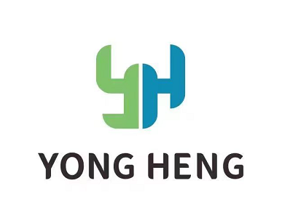
Company profile
Linhai yongheng Auto Parts Technology Co., Ltd
No. 1289, Huifeng South Road, Jiangnan District, Linhai City, Taizhou City, Zhejiang Province, China

Slide 2
CONTENTS
01 Company Profile
02 Products and R&D
03 Capacity
04 Customer

Slide 3
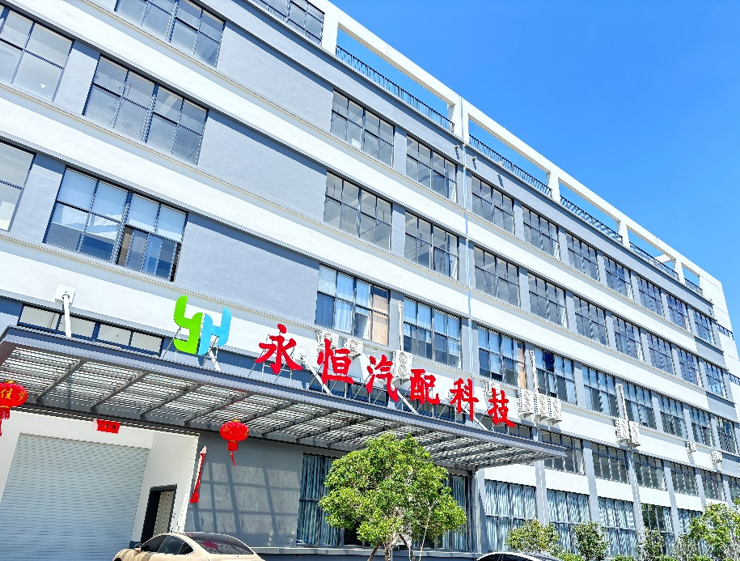
01 Company Profile
Company Profile
Company Introduction
Company Development History
Company Sales History
Enterprise Qualification
临海市永恒汽配科技有限公司
Linhai Yongheng Auto Parts Technology Co., Ltd.

Slide 4
Company Introduction
Established: 1994
Quality Management System: IATF 16949
Area: 15,000 square meters
Number of staffs: 100, includes 15 R & D staffs
Intellectual Property: 5 invention patents and more than 40 utility model patents
Products: More than 300 products which include: quick connectors, fuel pipe assemblies, water pipe assemblies, pipeline dust covers
Main customers(Tier 2): FAW, Geely, Changan, Foton, and Shaanxi Automobile, Great Wall, Hyundai

Slide 5
Company Development History
1994-Established
01
2010- Occupy a place in the aftermarket at home and abroad
02
2013- Enter commercial vehicle OEM market
03
2015- One of top suppliers for commercial vehicle field in China
04
2018- Enter the passenger car market
05
2023-Recognized as an advanced manufacturing enterprise in Taizhou, Zhejiang
06

Slide 6
Company Sales History

Slide 7
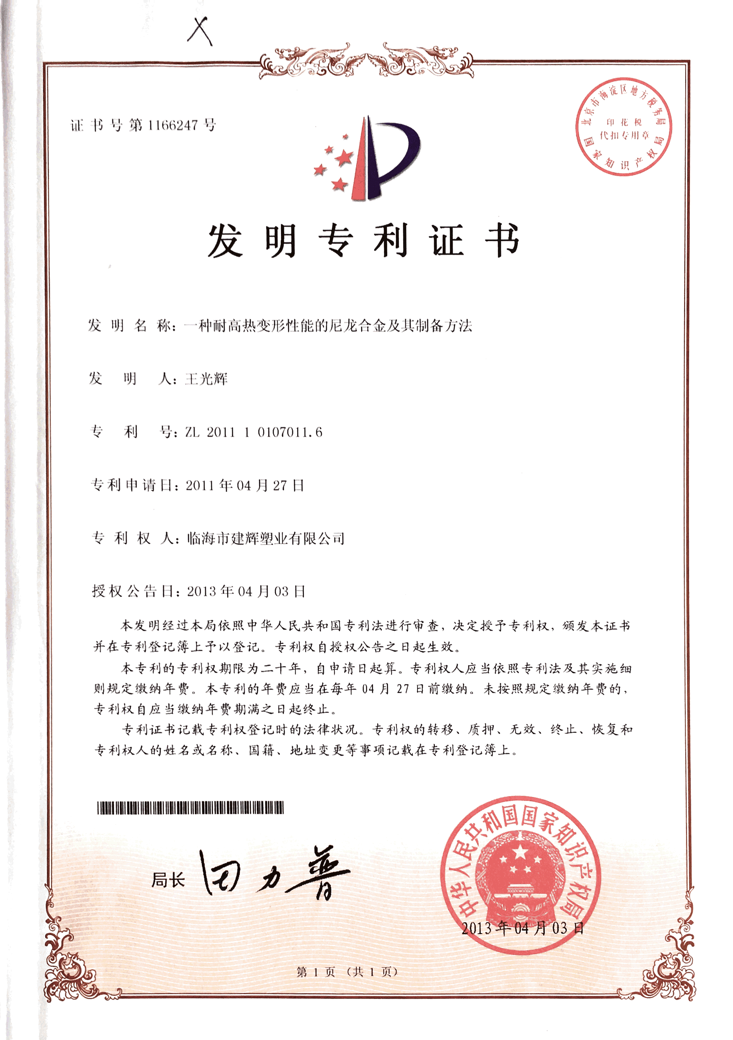
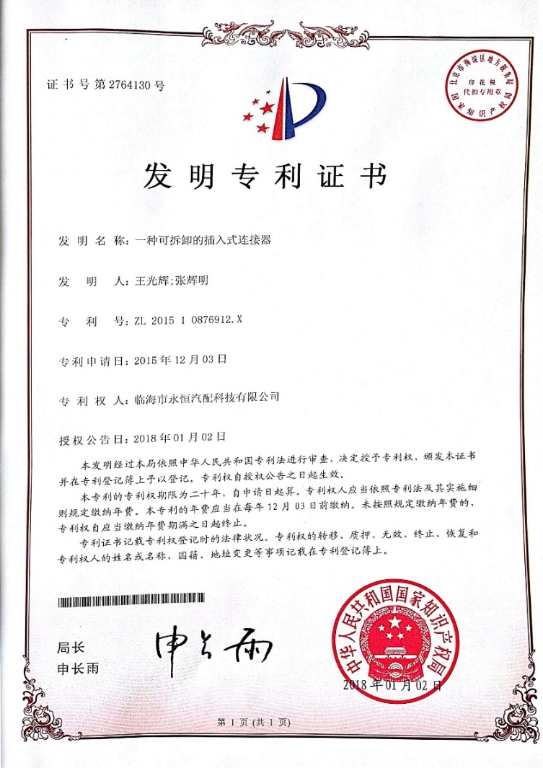
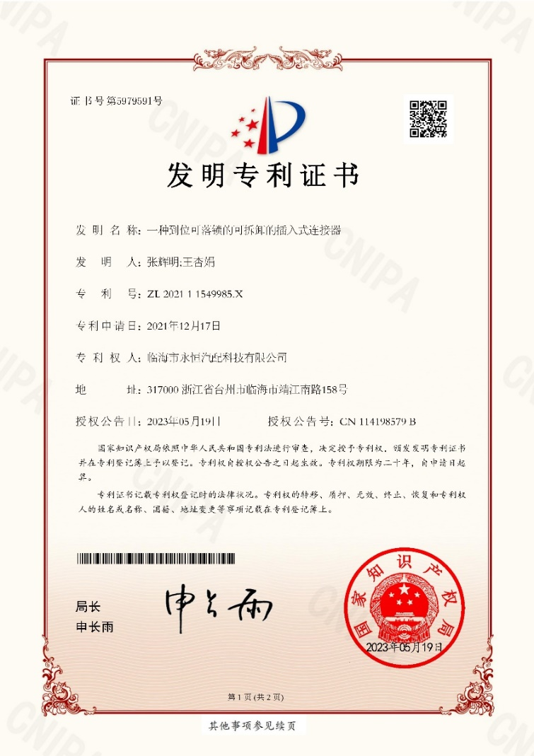
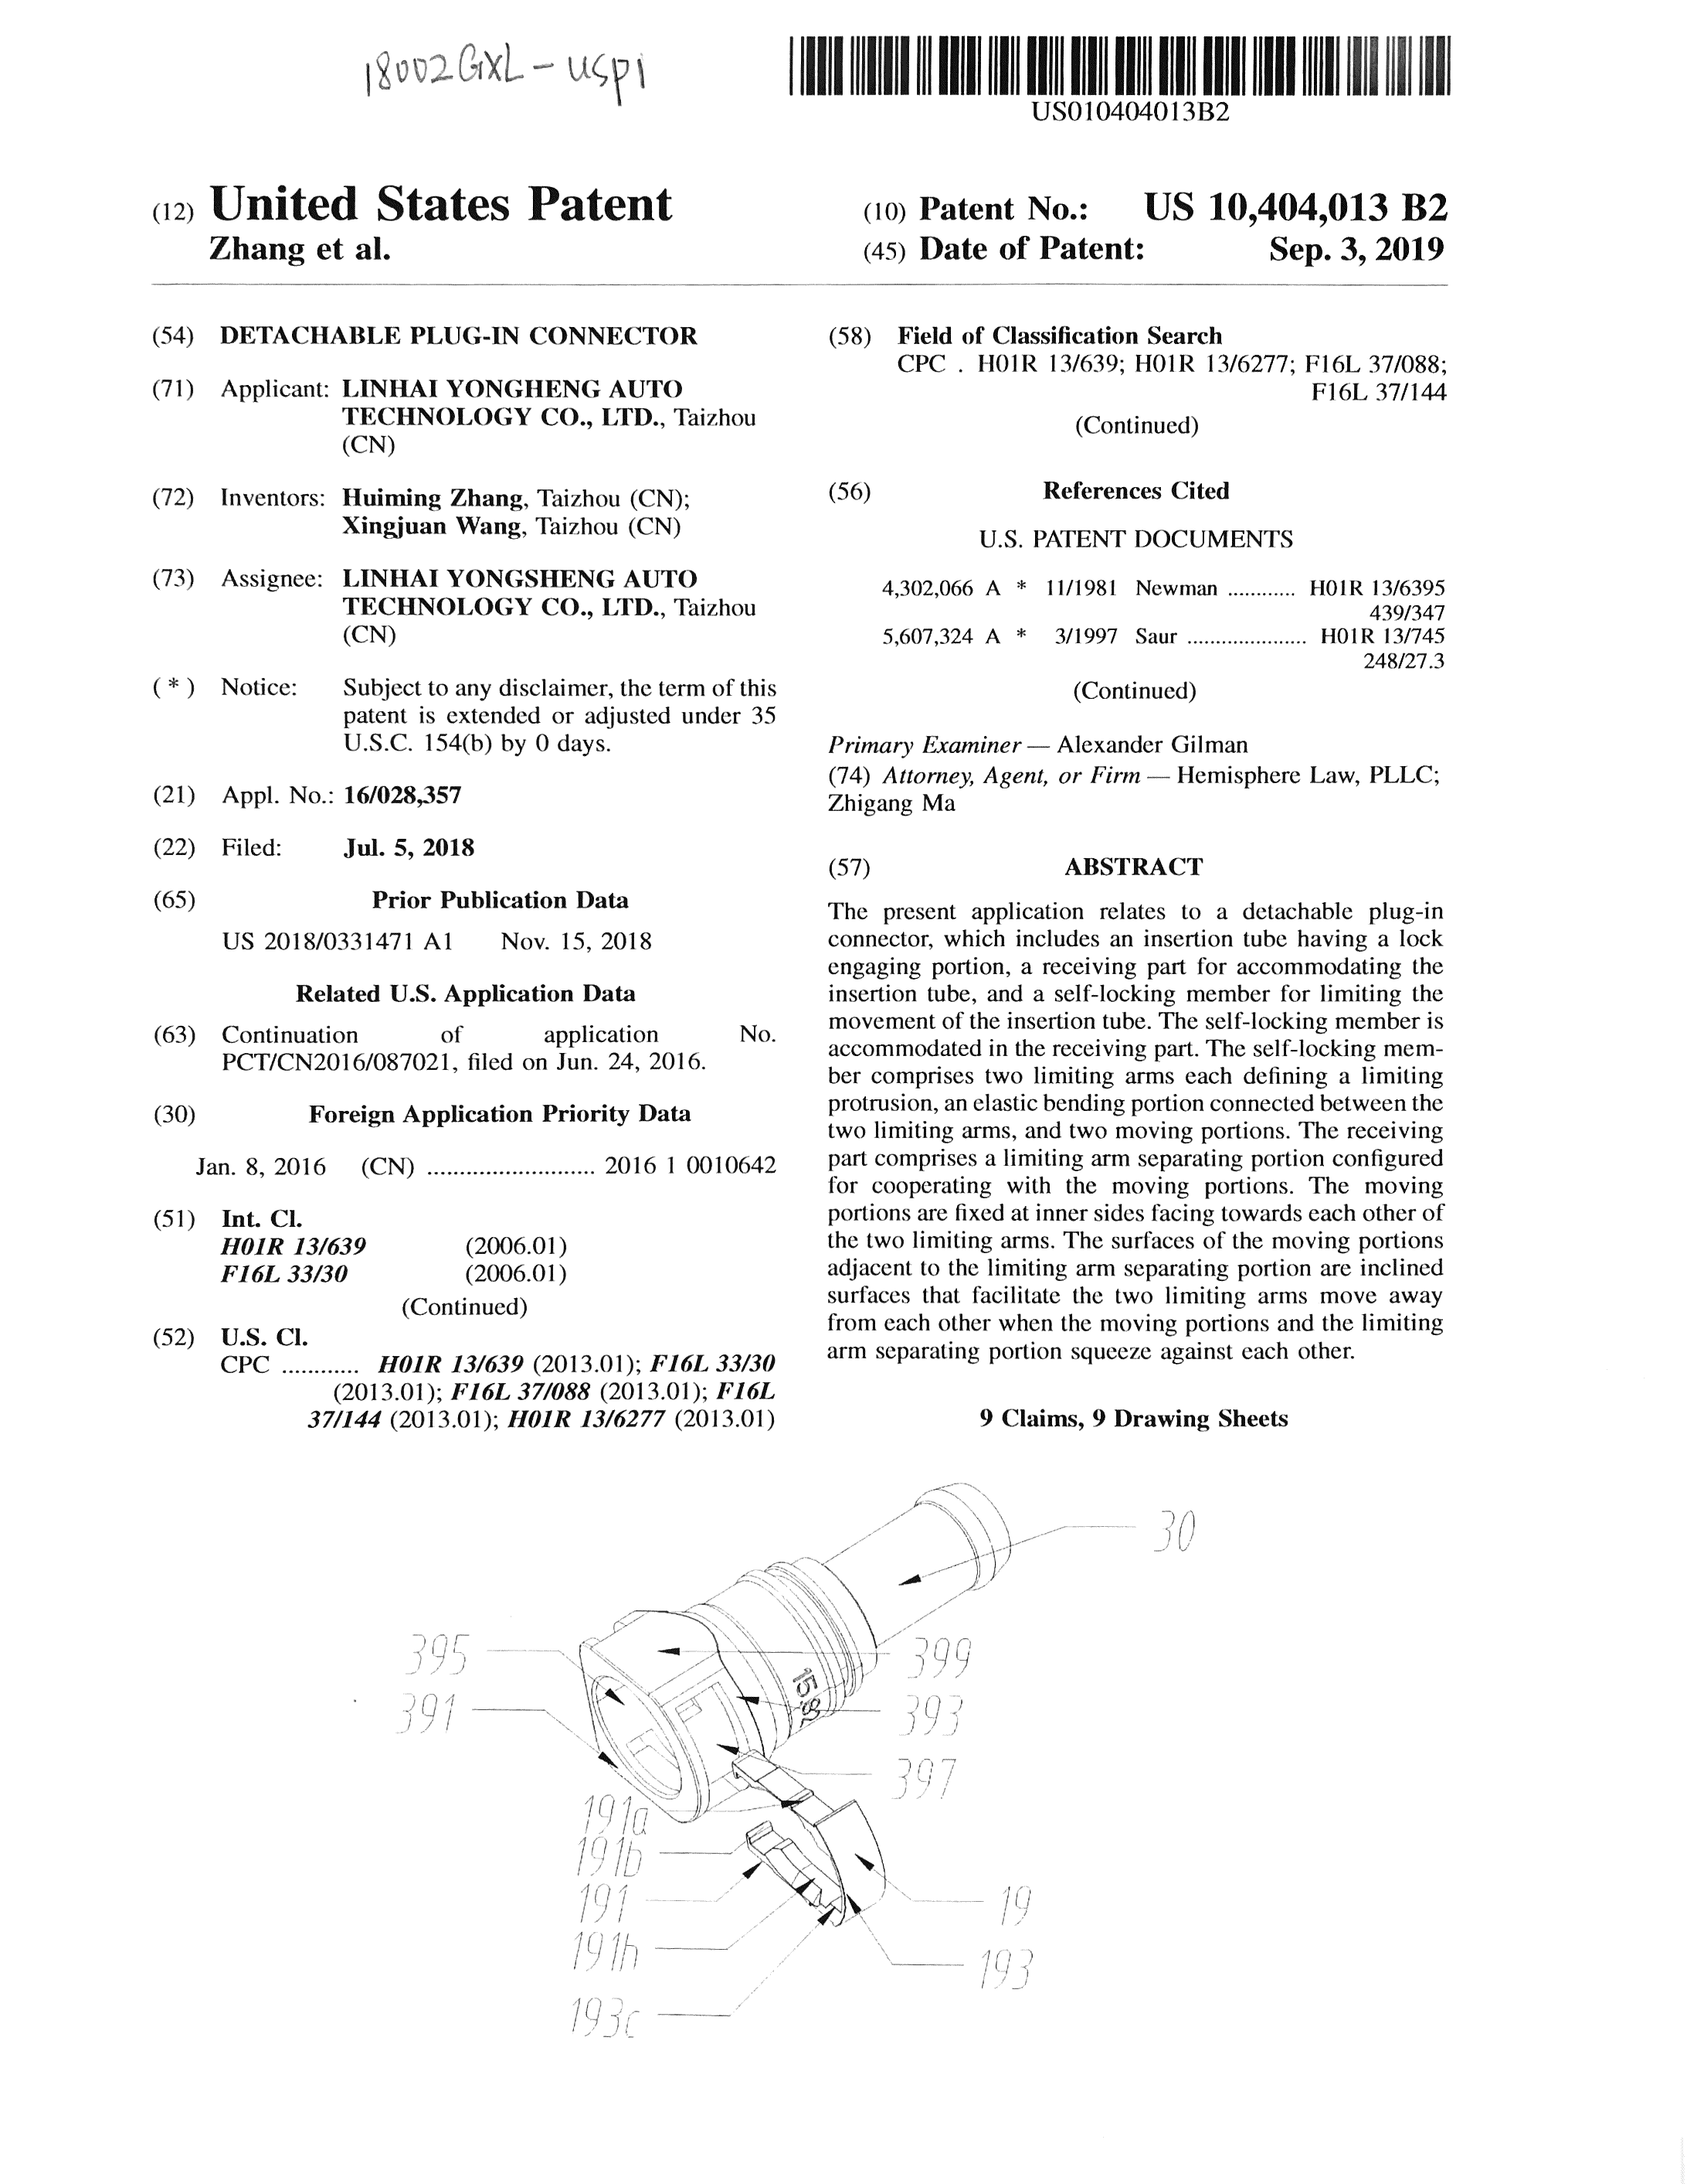
Enterprise Qualification
47 valid patents in total, including 5 patents for inventions.

Slide 8

02 Products and R&D
Products and R&D
Product Introduction
Products
R&D
Equipment
Product performance
02
——CONTENTS——

Slide 9
Product Introduction
There are 35 set injection molding machines and 1 set German Agbo 470C.
There are fully automatic assembly lines for SAE QC 7.89/8.0, 9.89/10, 11.8, 15.82/16.0.
There are semi-automatic assembly lines for SAE QC 7.89, 9.49, 11.8, 17.5.
Perform GP12 process control.
There are more than 300 connectors, including: SAE QC, VDA QC, Oil return QC, VOSS-246, VOSS-230 and others.
More products are been developed.

Slide 10





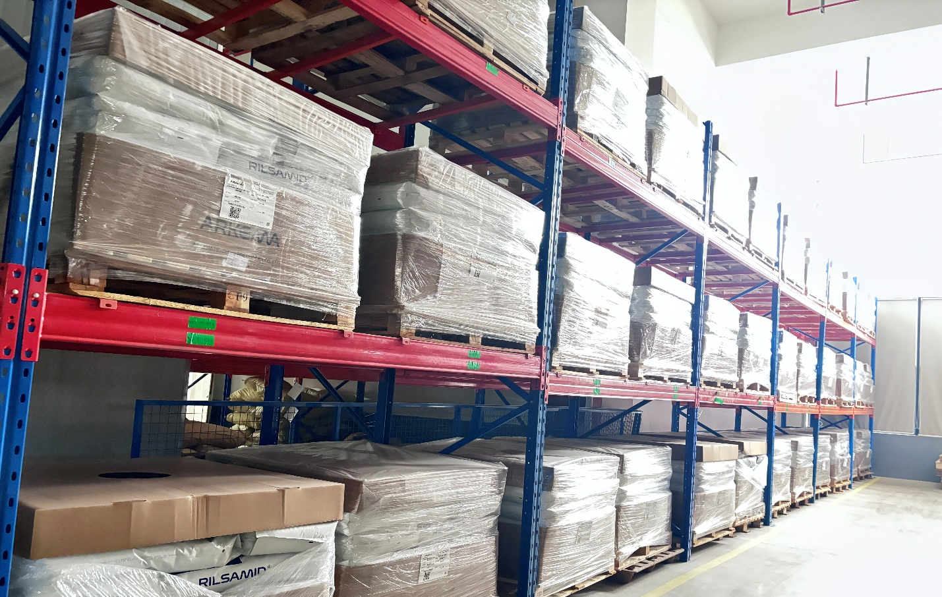
Sources of Raw Materials

Slide 11
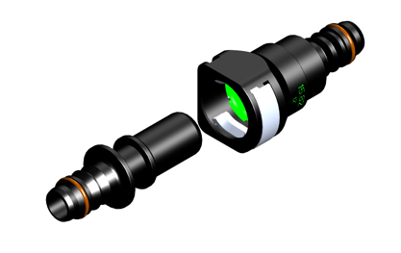

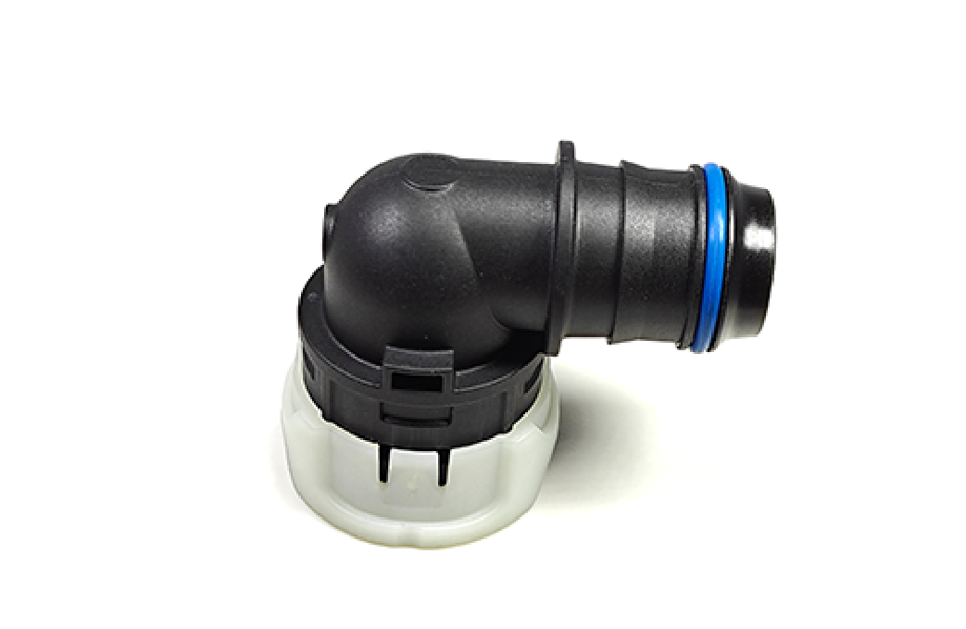
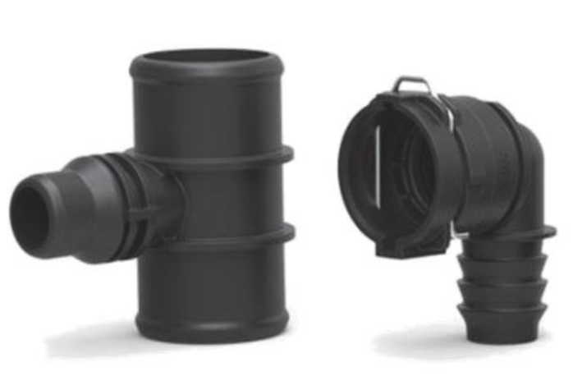
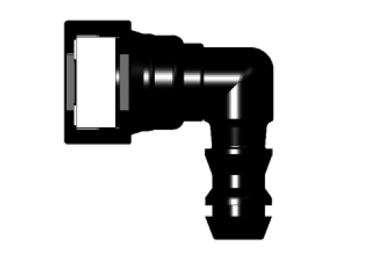
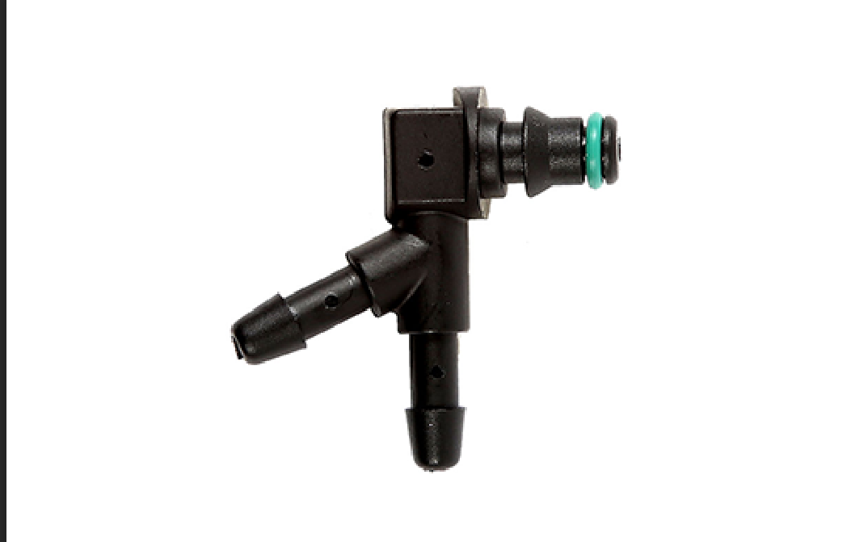
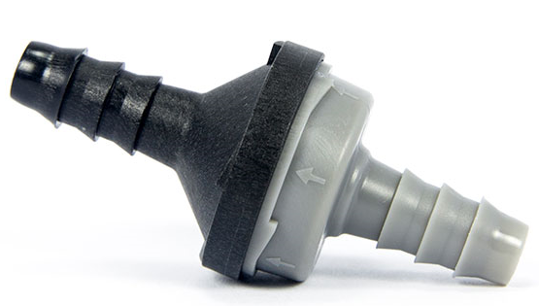
Products
Quick connector-SAE
Quick connector-VDA
CQC
Applied to fuel(liquid/vapor) system, urea system, methanol resistant system, coolant system
Applied to coolant system
Applied to coolant system
Wiper Pipe QC
Oil Return Connector
Check Valve
Applied to windshield washer
Applied to fuel(liquid) system
Applied to fuel(liquid/vapor) system

Slide 12
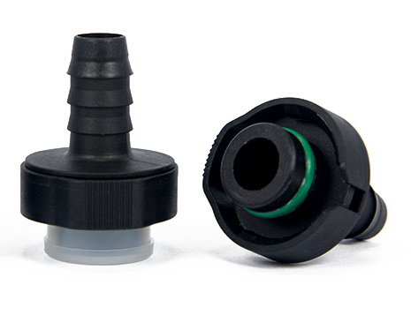
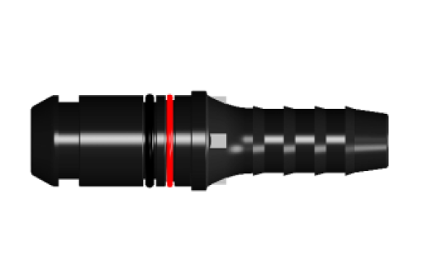
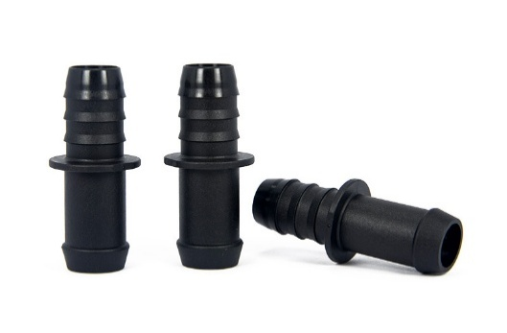
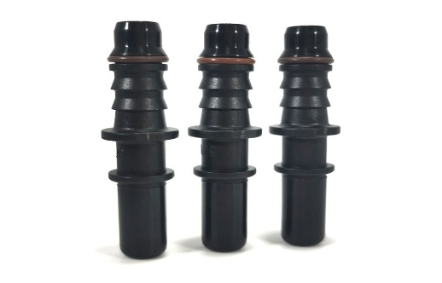
Products
Quick Connector-246
Quick Connector-230
Adapters
Applied to fuel(liquid/vapor) system, urea system, methanol resistant system, coolant system
Applied to fuel(liquid/vapor) system, urea system, methanol resistant system, coolant system
Applied to fuel(liquid/vapor) system, urea system, methanol resistant system, coolant system
Male End Pieces
Applied to fuel(liquid/vapor) system, urea system, methanol resistant system, coolant system

Slide 13
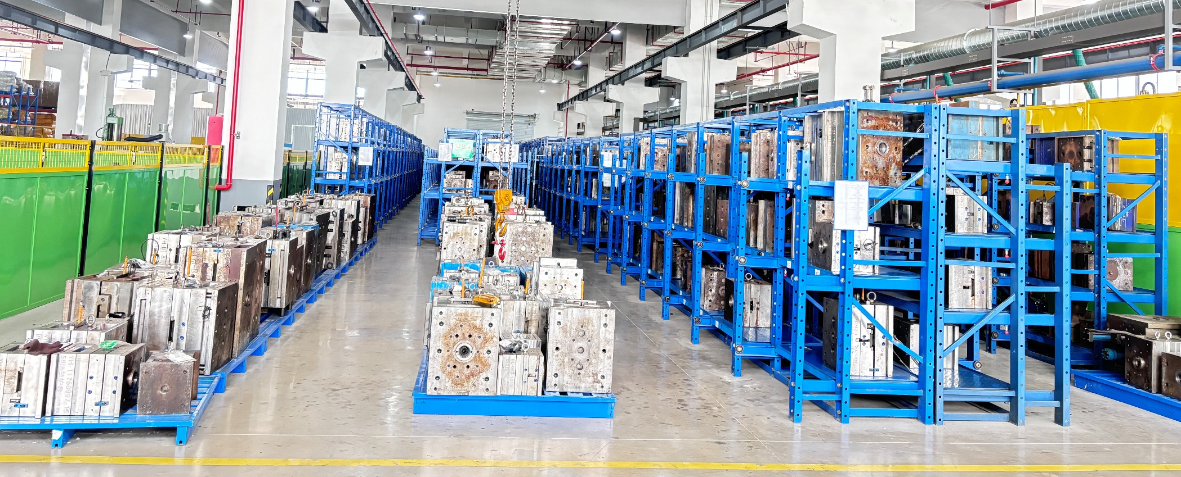
R&D
Independently design and develop molds, with in-house mold maintenance and repair capabilities.
New products are added every year.
Able to design and develop products according to customer requirements.

Slide 14
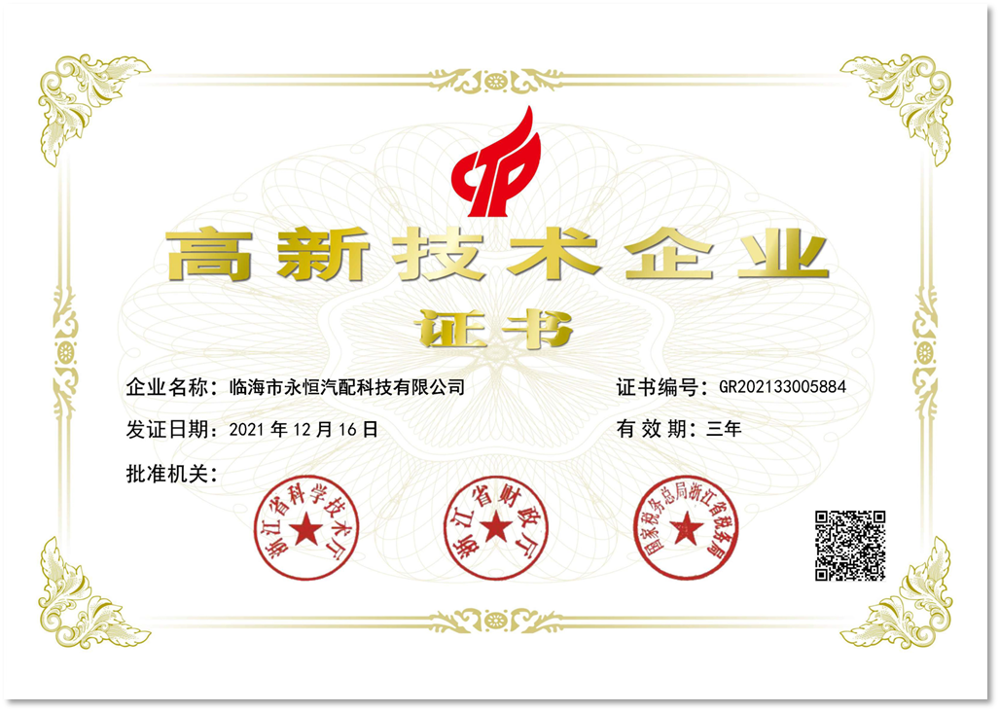
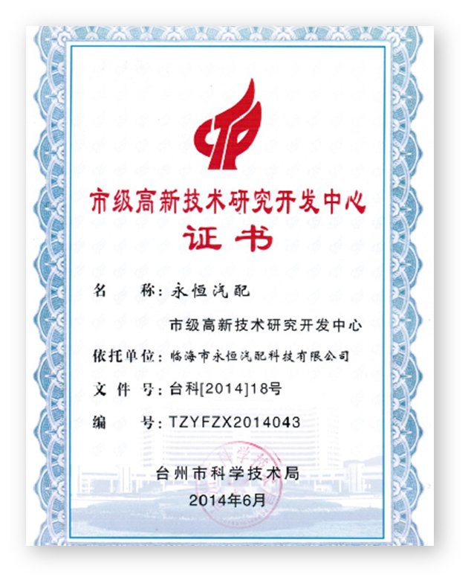
R&D- Certificates
Zhejiang Province Technology-based SME
Taizhou City High-tech Enterprise
Taizhou City High-tech Research and Development Center

Slide 15
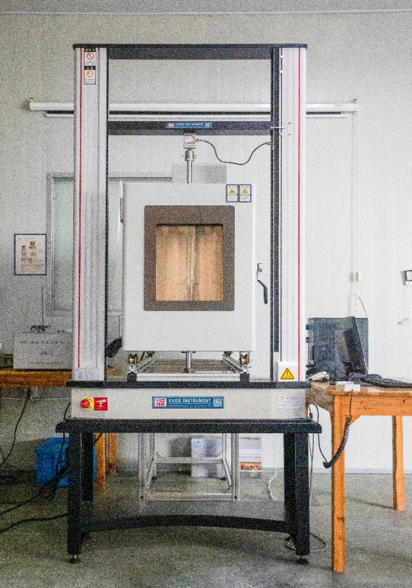
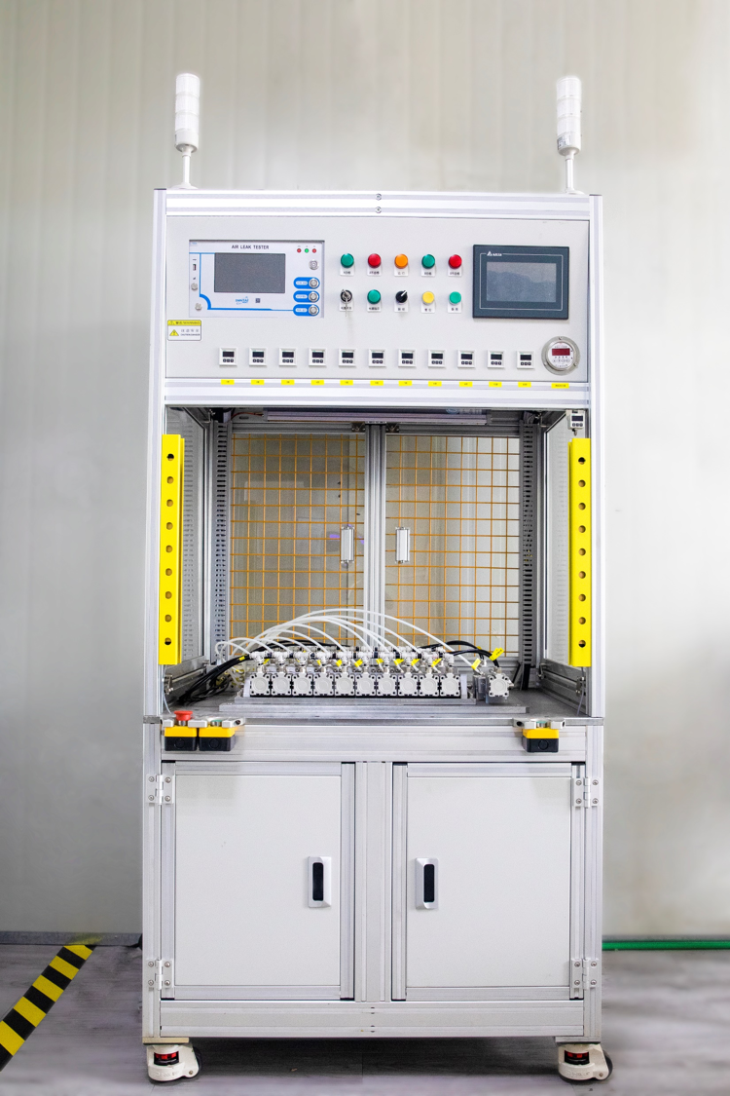
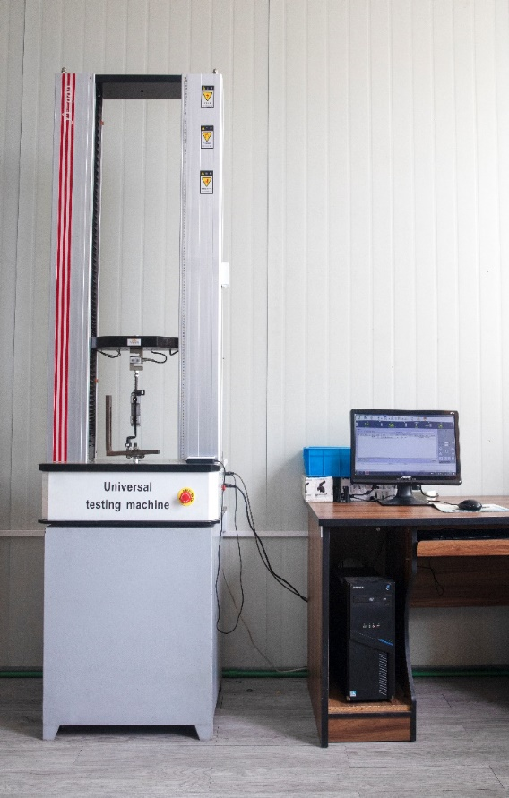
Equipment-R&D Test
Performance testing of
high and low temperature tensile
machines (plastic particles, joints)
Pressurized blasting test bench
Normal temperature tensile test bench

Slide 16
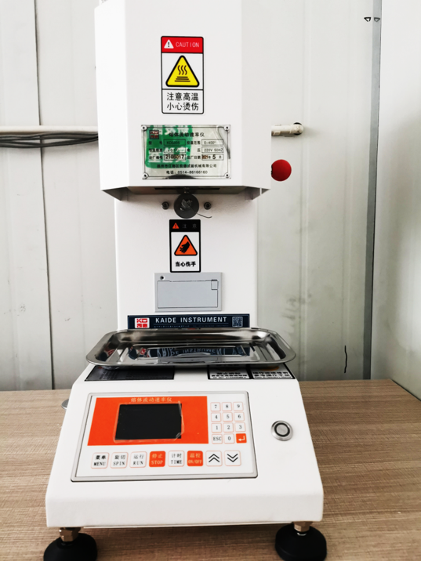
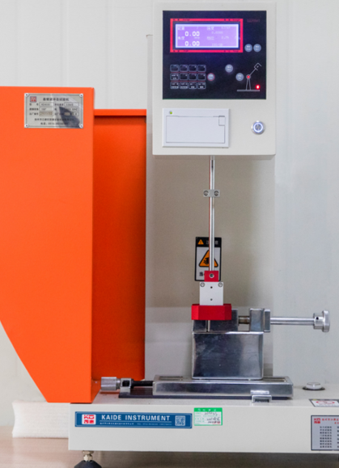
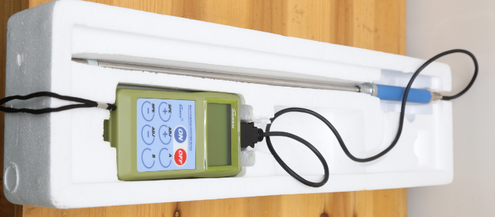
Equipment-R&D Test
Determination of Melt Index
of Plastic Particles
Plastic Impact Test
Dry humidity monitoring of
plastic particles

Slide 17
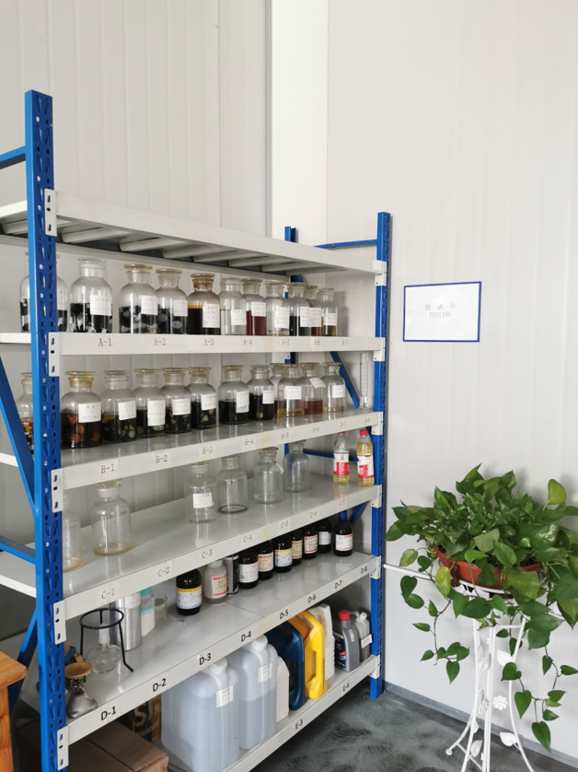
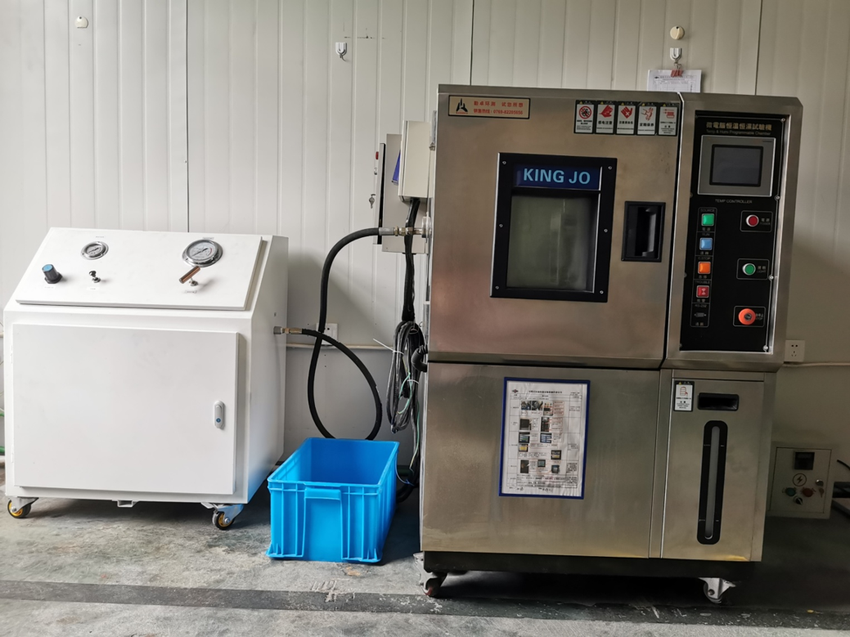
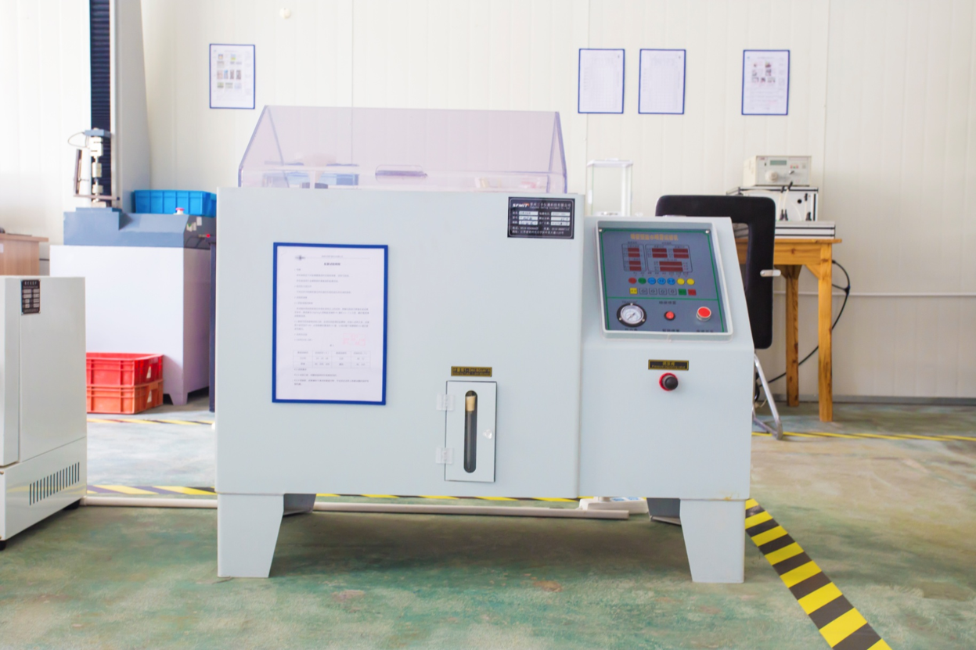
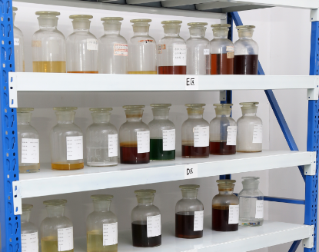
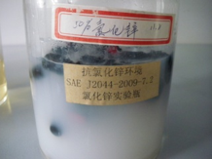
Equipment-R&D Test
High and low temperature
alternating test
Salt spray test
Fuel compatibility test
Anti-external chemical test
Zinc chloride resistance test

Slide 18
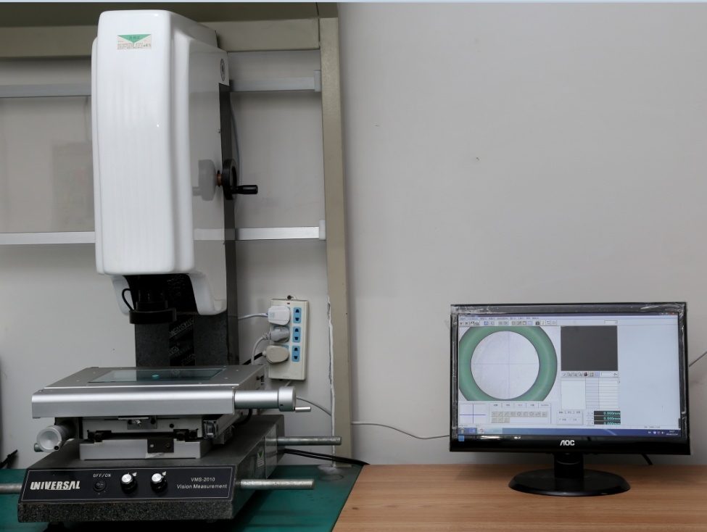
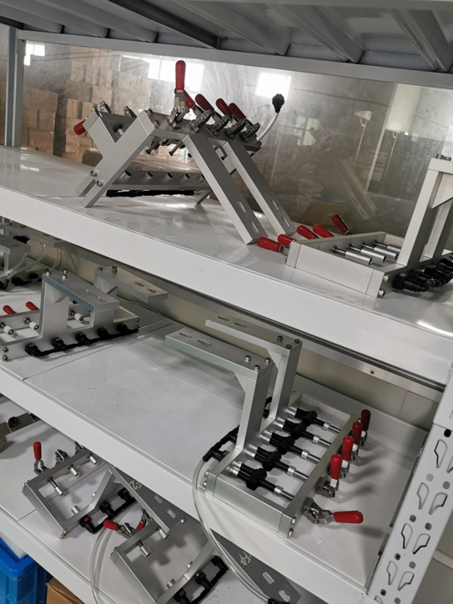
Equipment-Inspection and Testing
Dimension Test for O-rings
Non-standard product leakage
inspection tooling

Slide 19
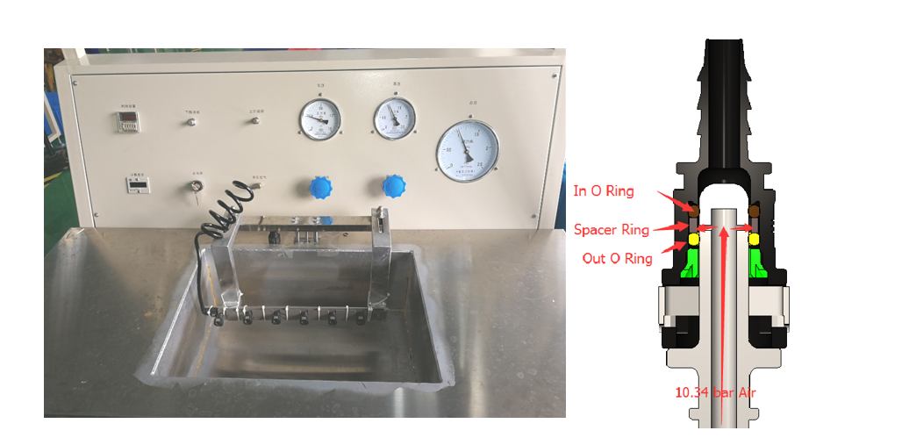
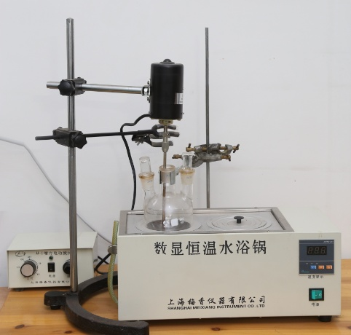
Equipment-Inspection and Testing
100% leak test
Self-designed and manufactured online leak detection
Leakage probe, the size conforms to the SAE standard, the outer diameter of the probe uses the following tolerance: Φ 7.81-7.83,Standard size of 7.89 male connector: Φ 7.89±0.06
Constant temperature
water bath pot

Slide 20
Product performance
Partial List of Test Items in SAE Standards
Temperature Cycling Test
Fuel Compatibility and Chemical Resistance
Insertion and Pull-out Force Tests
High Temperature Resistance Test of Plastics
Quick connector Leak Test

Slide 21
03 Capacity
Capacity
Quality management
Production Equipment
Assembly workshop
03
——CONTENTS——

Slide 22
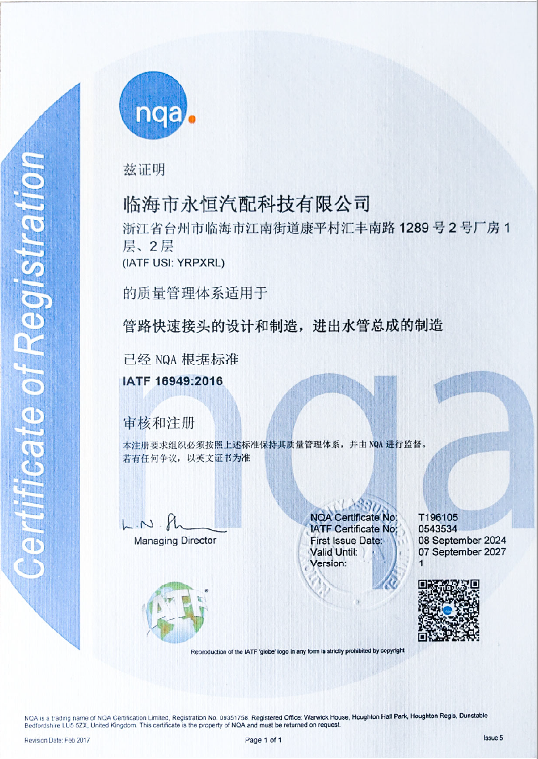
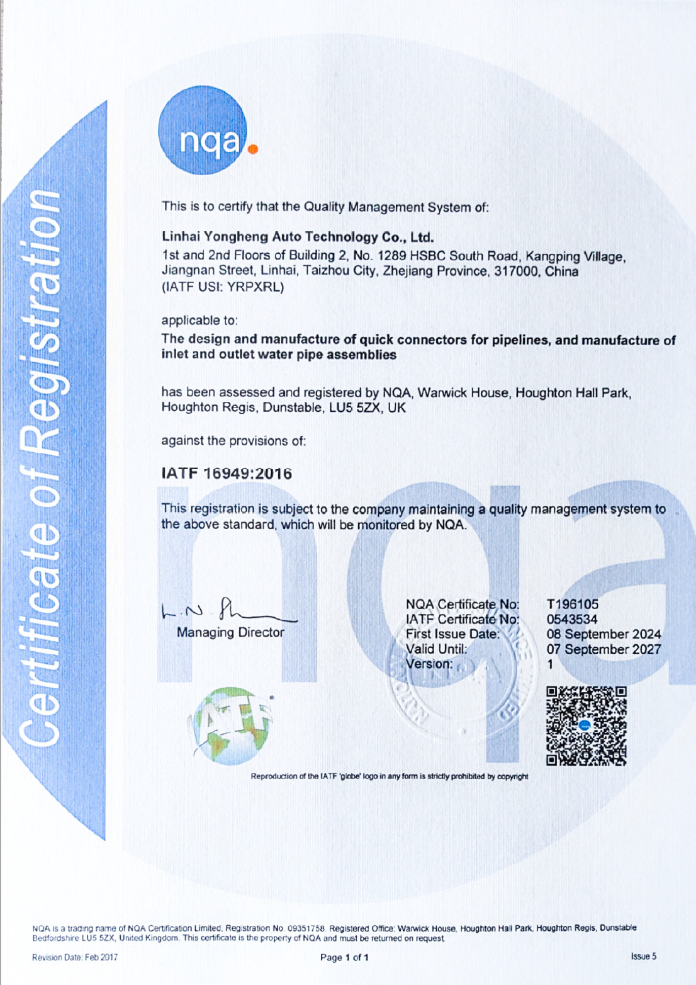
Quality management
IATF16949: 2016 Certification

Slide 23
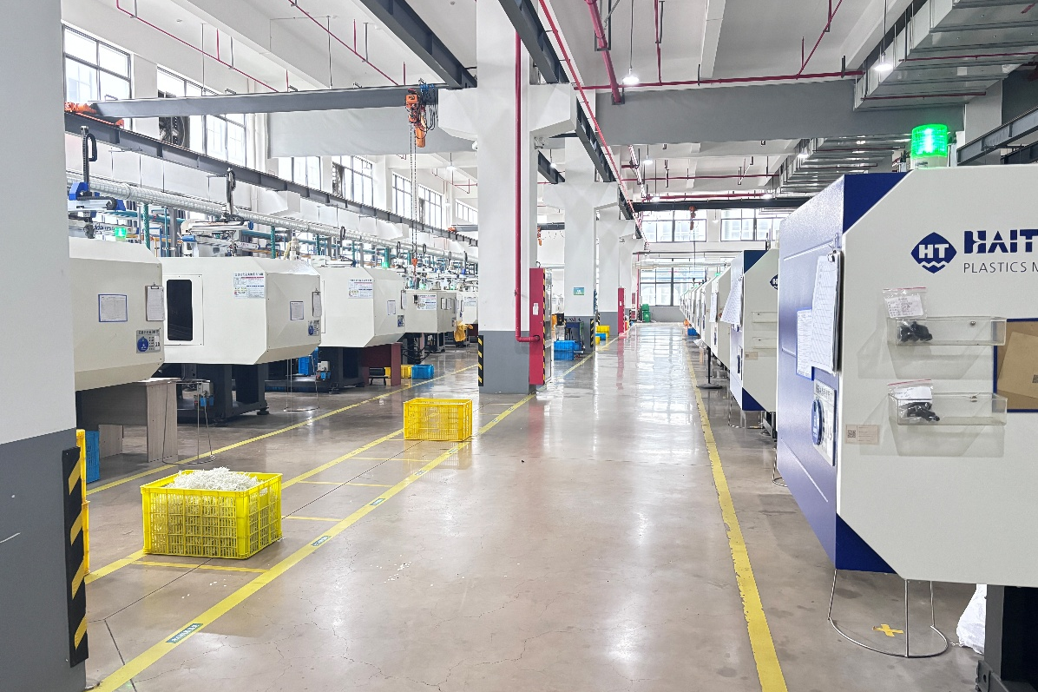
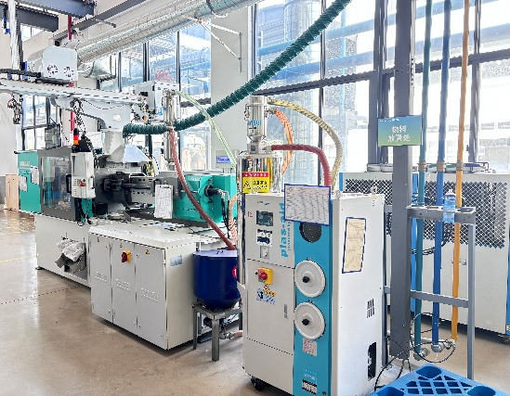
Production Equipment-Injection
There are 35 three-axis manipulators， which can form a one-piece conveyor belt for injection molding machines.
1 set German Agbo 470C

Slide 24
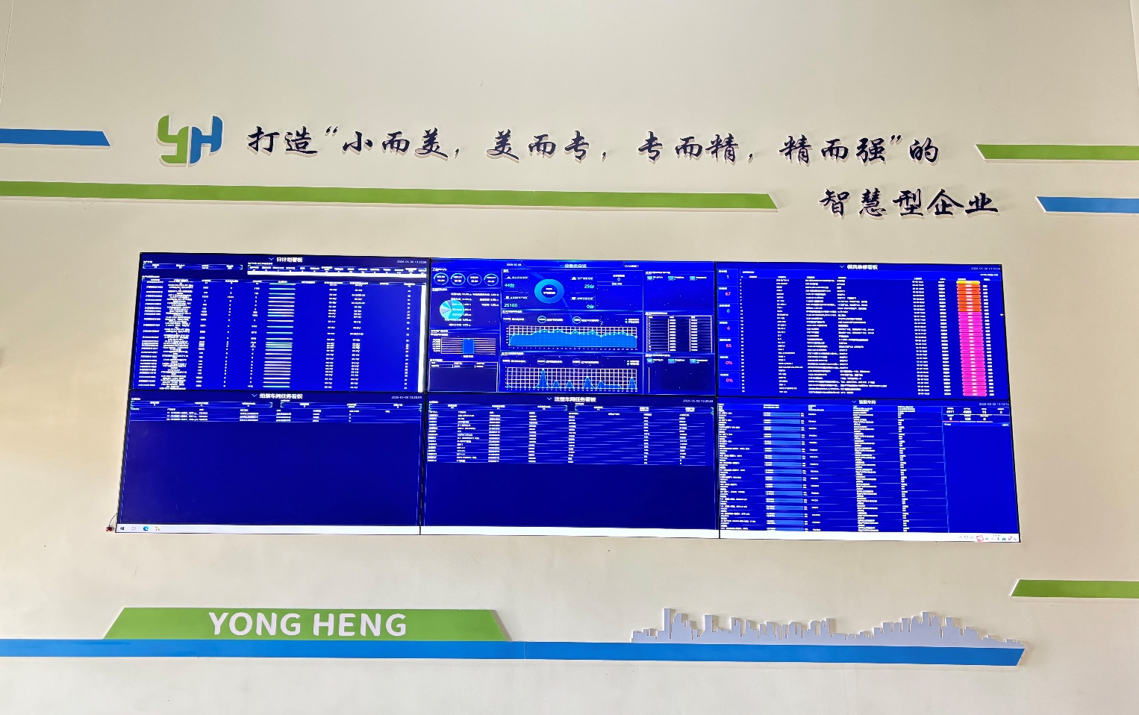
MES production management system
Production data is documented to facilitate real-time monitoring and early detection of non-conformities or abnormalities in procurement, receiving inspection, outsourced processing, and in-house production. Data-driven analysis is applied to continuously identify areas for improvement, thereby reducing manufacturing costs, shortening lead times, and enhancing operational efficiency.

Slide 25
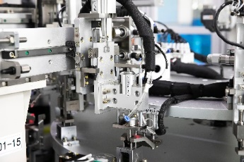
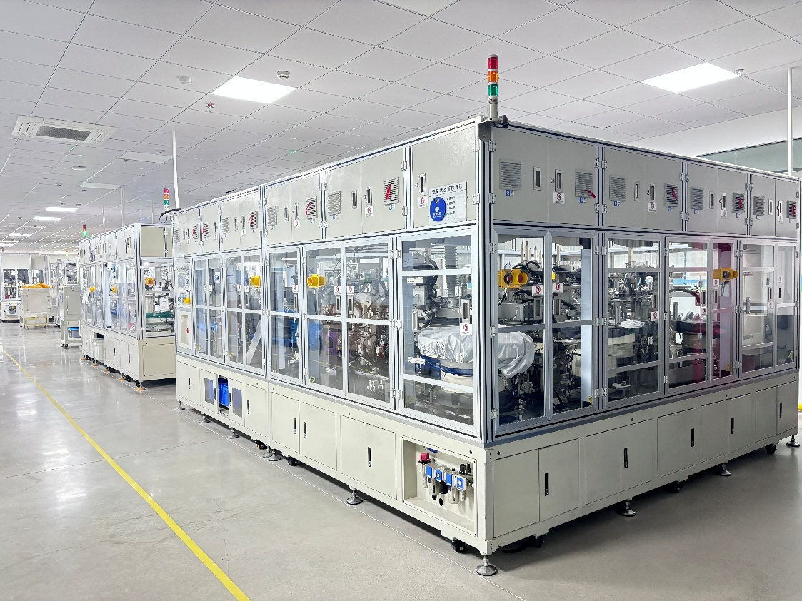
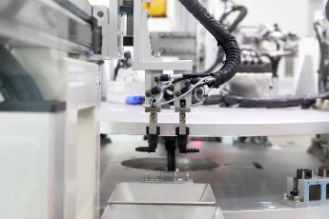
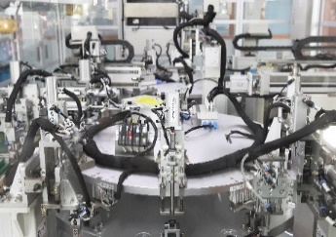
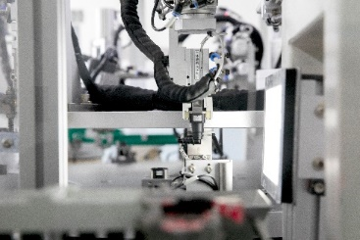
Equipment-Assembly
5 set automatic assembly machines

Slide 26
04 Customers
Customers
Main Customers-Tier 2
04
——CONTENTS——

Slide 27

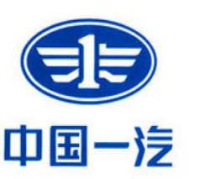
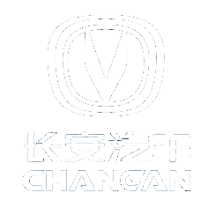
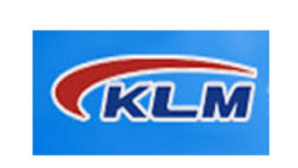
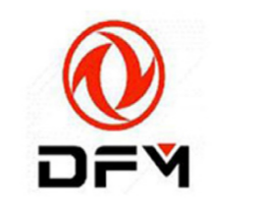
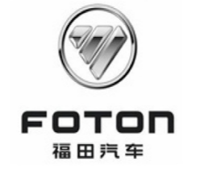






Main Customers-Tier 2

Slide 28

New Production Plant
Yongheng will move to the Self-built Factory at the end of 2026.

Slide 29
THANKS
临海市永恒汽配科技有限公司
Linhai yongheng Auto Parts Technology Co., Ltd

