Slide 1
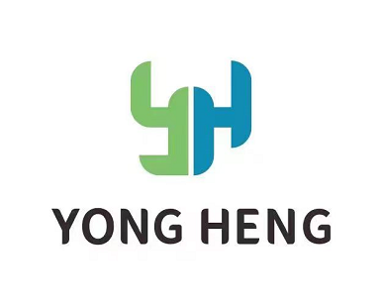
Specialization | Quality | Service
Company Profile
临海市永恒汽配科技有限公司
Linhai yongheng Auto Parts Technology Co., Ltd
No. 1289, Huifeng South Road, Jiangnan District, Linhai City, Taizhou City, Zhejiang Province, China
Email: Nicole@automotivequickconnect.com
Website: www.automotivequickconnect.com

Slide 2
CONTENTS
01 Company Profile
02 Products and R&D
03 Capacity
04 Customer

Slide 3
01 Company Profile
Company Profile
Company Introduction
Company Development History
Company History Sales Chart
Intellectual Property
临海市永恒汽配科技有限公司
Linhai Yongheng Auto Parts Technology Co., Ltd.

Slide 4
Company Introduction
Established: 1994
Quality Management System: IATF 16949
Area: 15,000 square meters
Number of staffs: 100, includes 15 R & D staffs
Intellectual Property: 4 invention patents and more than 40 utility model patents
Products: More than 300 products which include: quick connectors, fuel pipe assemblies, water pipe assemblies, pipeline dust covers
Main customers(Tier 2): FAW, Geely, Changan, Foton, and Shaanxi Automobile, Great Wall, Hyundai

Slide 5
Company Development History
1994-Established
01
2010- Occupy a place in the aftermarket at home and abroad
02
2013- Enter commercial vehicle OEM market
03
2015- One of top suppliers for commercial vehicle field in China
04
2018- Enter the passenger car market
05
2023-Recognized as an advanced manufacturing enterprise in Taizhou, Zhejiang
06

Slide 6
Intellectual Property

Slide 7

02 Products and R&D
Products and R&D
Product Introduction
Products
R&D
Equipment
Product performance
02
——CONTENTS——

Slide 8
Product Introduction
There are 35 set injection molding machines and 1 set German Agbo 470C.
There are fully automatic assembly lines for SAE QC 7.89/8.0, 9.89/10, 11.8, 15.82/16.0.
There are semi-automatic assembly lines for SAE QC 7.89, 9.49, 11.8, 17.5.
Perform GP12 process control.
There are more than 200 connectors, include: SAE, VOSS-246, VOSS-230 and others.
There are more than 30 SCR urea heating quick connectors, which include more than 10 laser welded connectors.
More products were developed, include valve series connectors such as one-way valves, shut-off valve, and check valves, wiper connectors, new energy vehicle connectors, VDA connectors, etc.

Slide 9
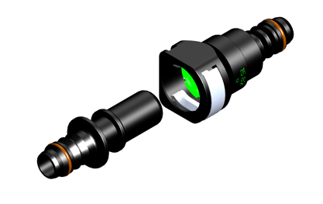

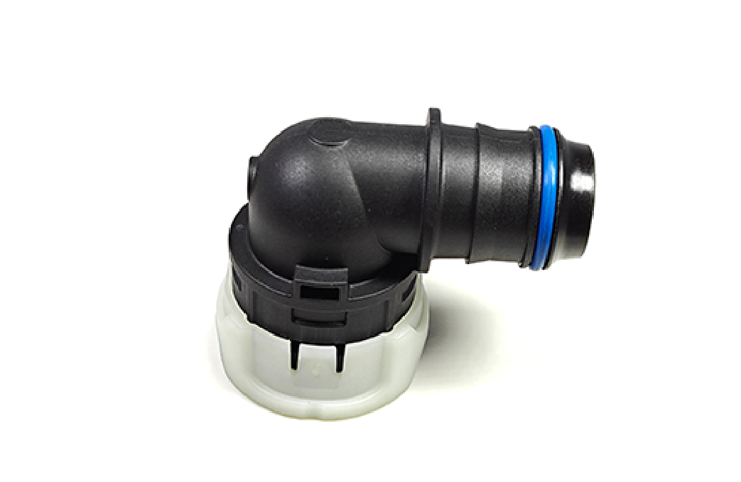
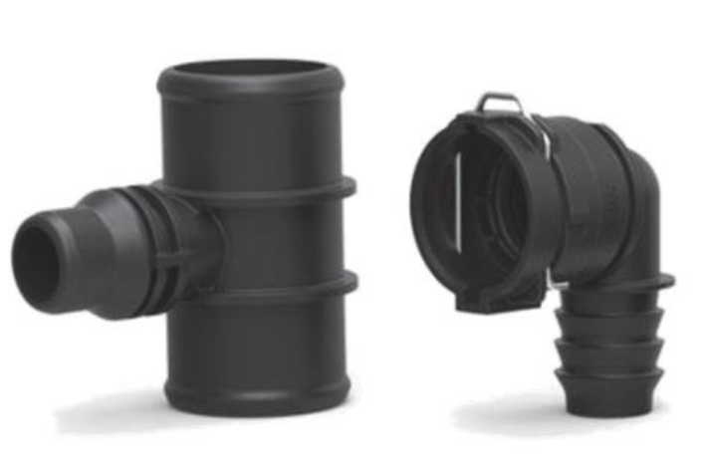
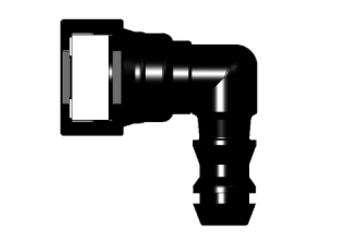
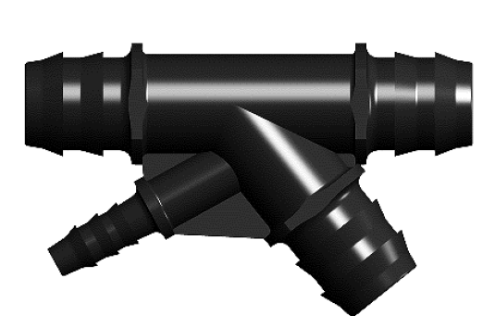
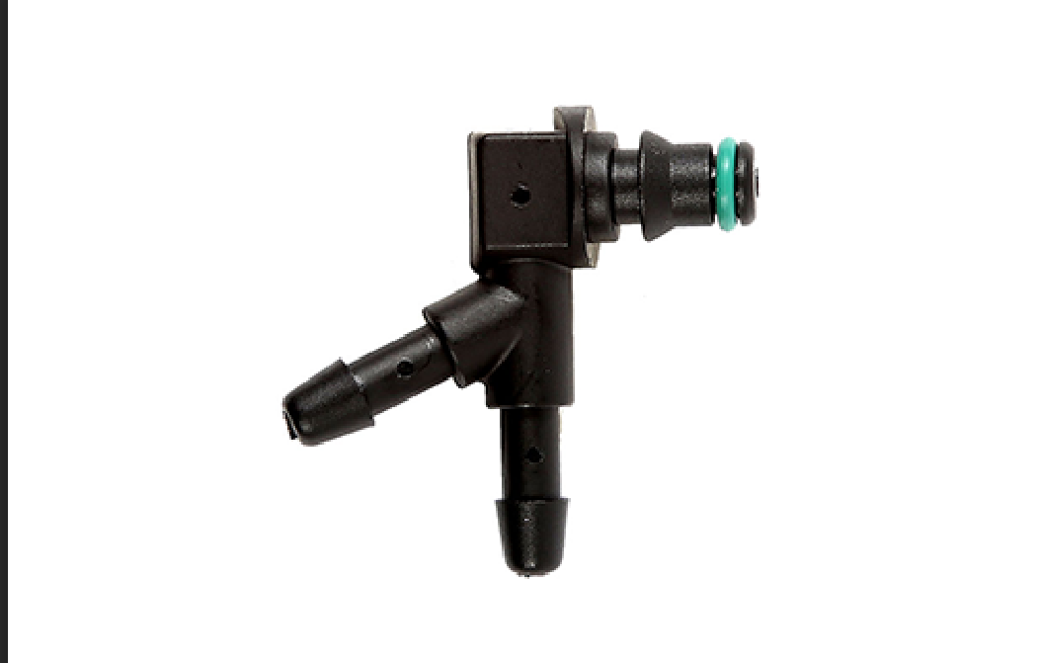
Products
Quick connector-SAE
Quick connector-VDA
CQC
Applied to fuel(liquid/vapor) system, urea system, methanol resistant system, coolant system
Applied to coolant system
Applied to coolant system
Wiper Pipe QC
Adaptor
Oil Return Connector
Applied to windshield washer
Applied to pipeline connecting and converting
Applied to fuel(liquid) system

Slide 10
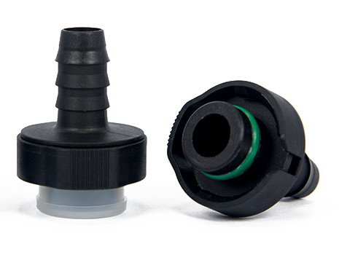
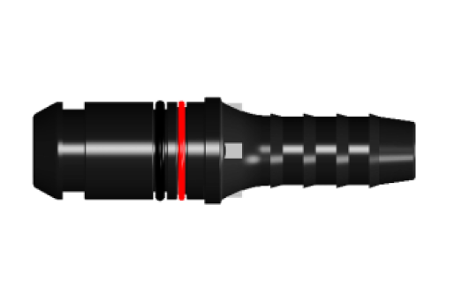
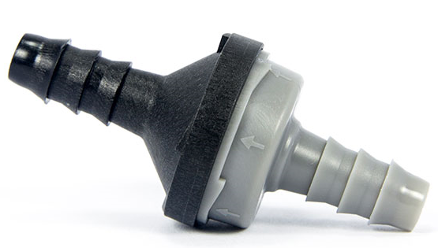
Products
Quick connector-246
Quick connector-230
Check Valve
Applied to fuel(liquid/vapor) system, urea system, methanol resistant system, coolant system
Applied to fuel(liquid/vapor) system, urea system, methanol resistant system, coolant system
Applied to fuel(liquid/vapor) system

Slide 11
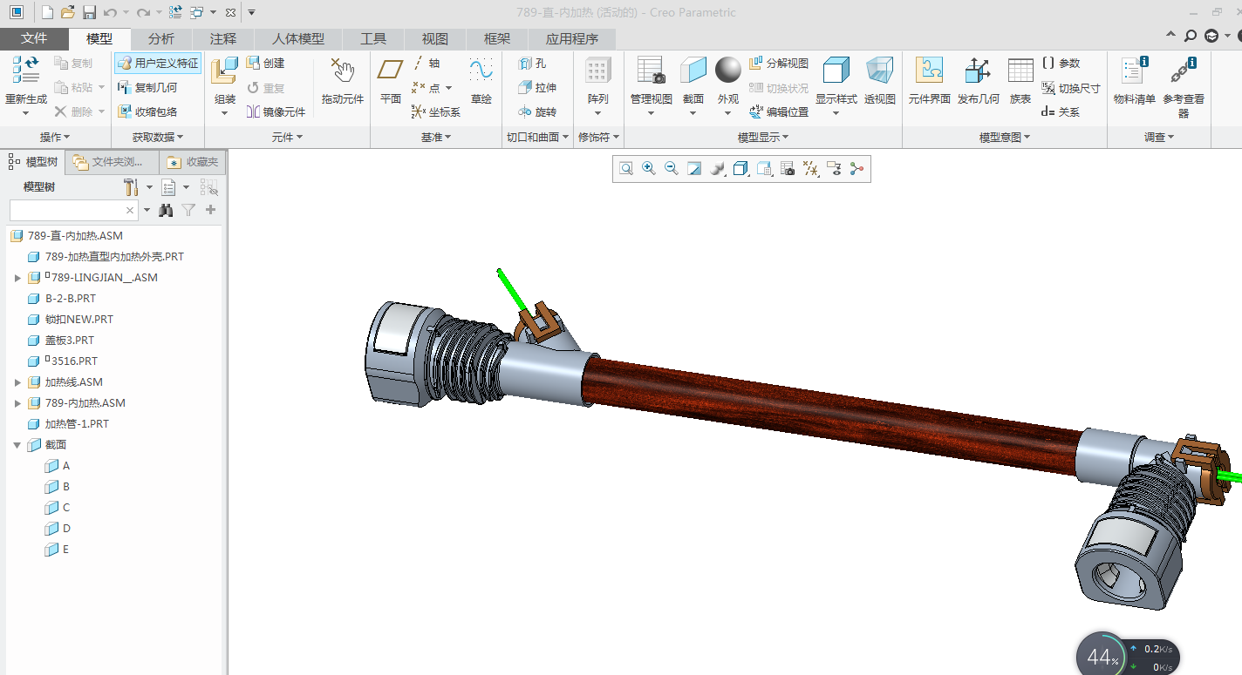
R&D-Software
Two-dimensional and three-dimensional software (AutoCAD, Pro/E, etc.) are used to design products and tooling drawings.

Slide 12
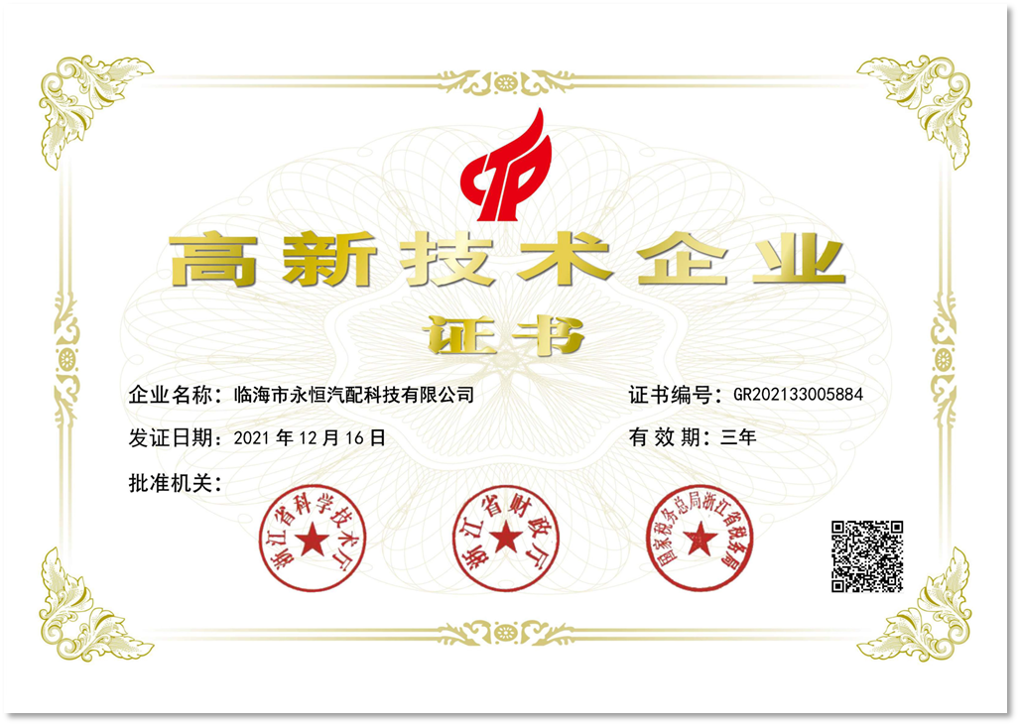
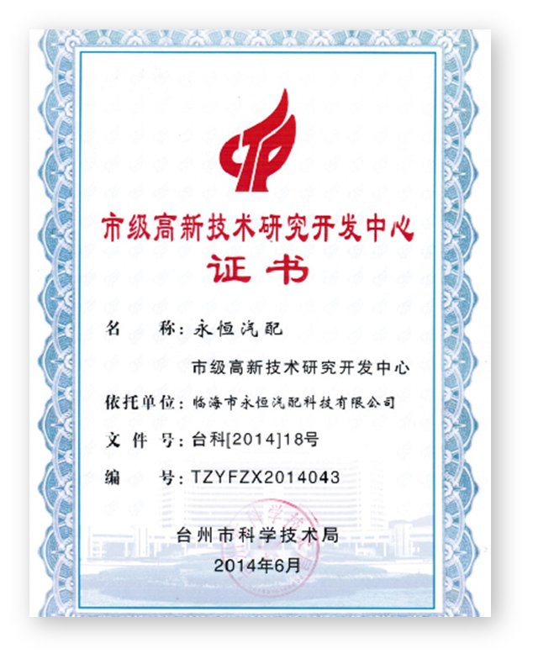
R&D- Certificates
Zhejiang Province Technology-based SME
Taizhou City High-tech Enterprise
Taizhou City High-tech Research and Development Center

Slide 13
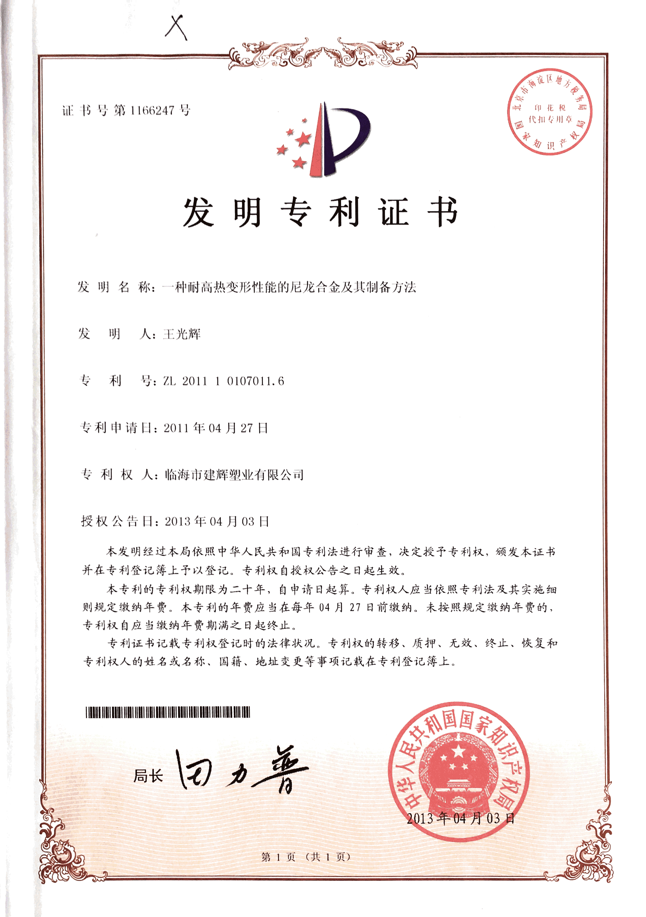
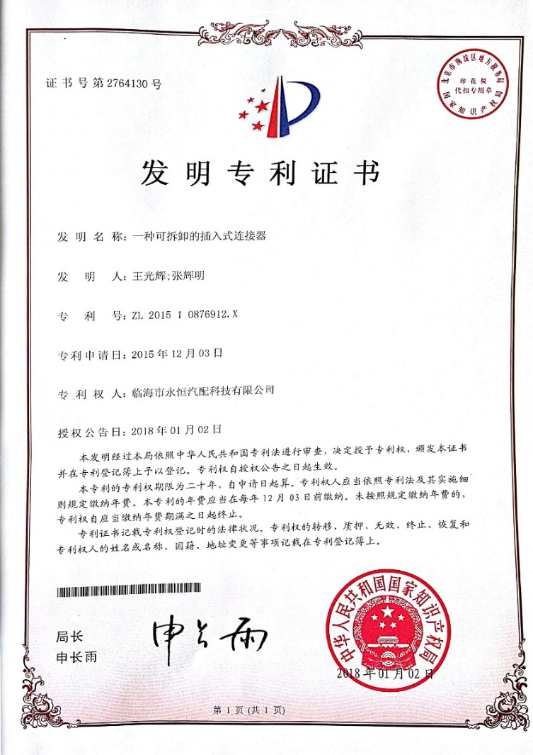
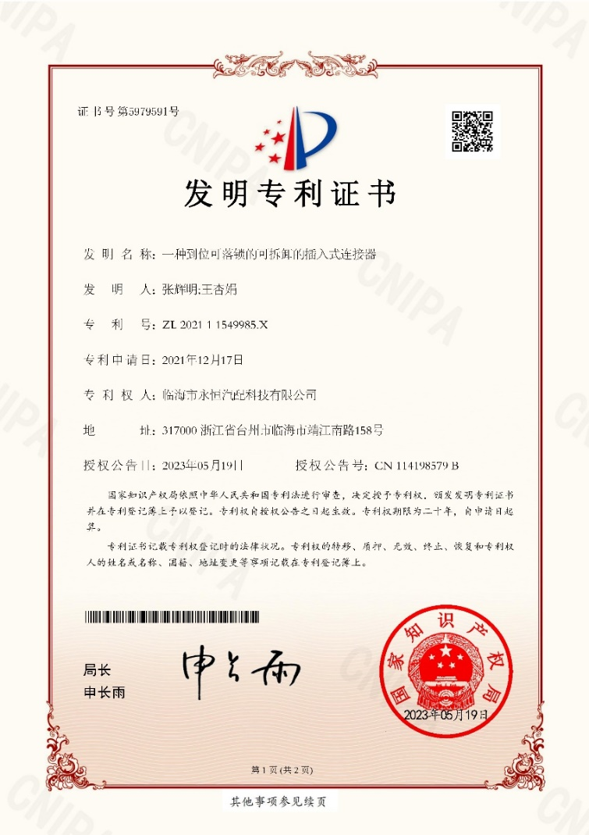
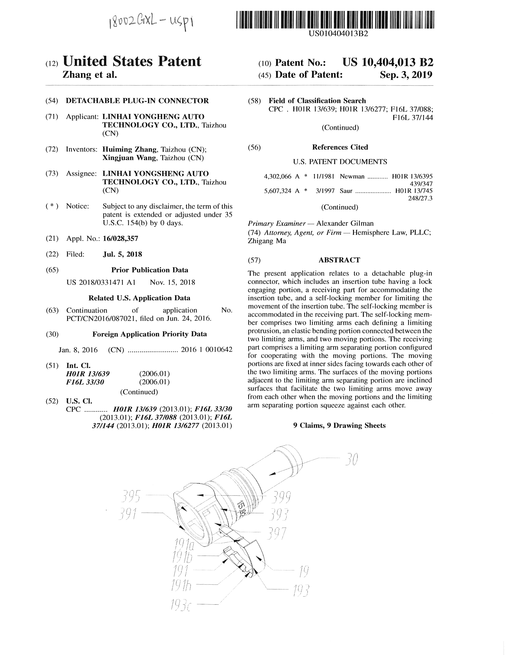
R&D-Patents

Slide 14
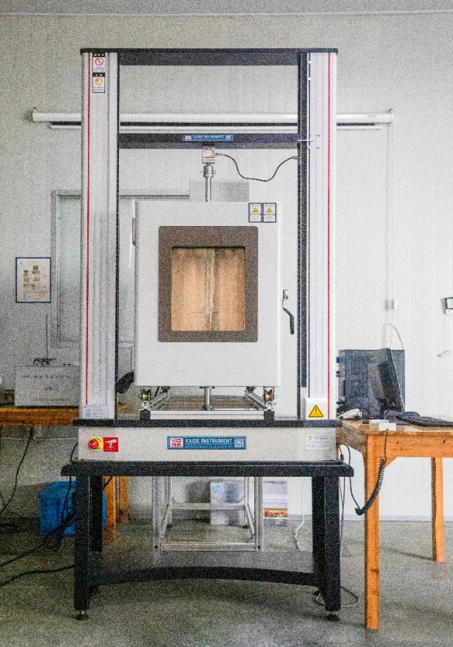
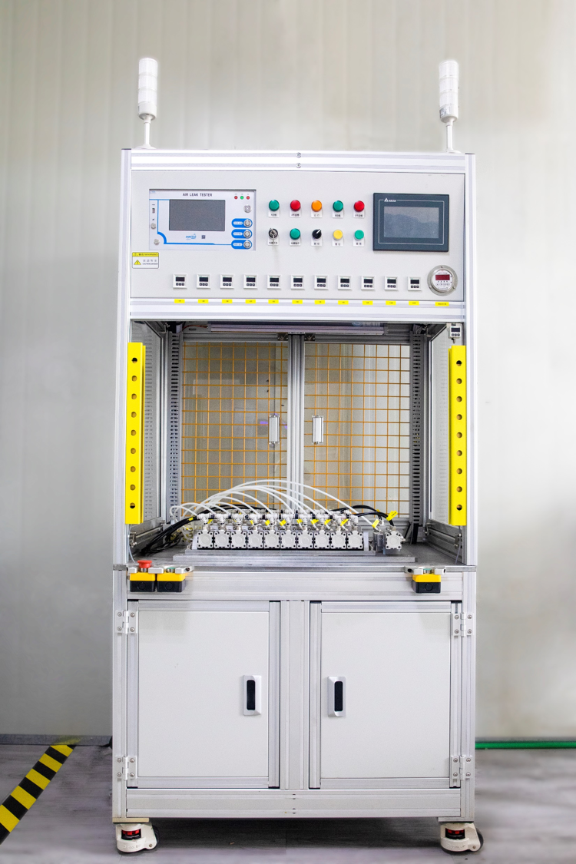
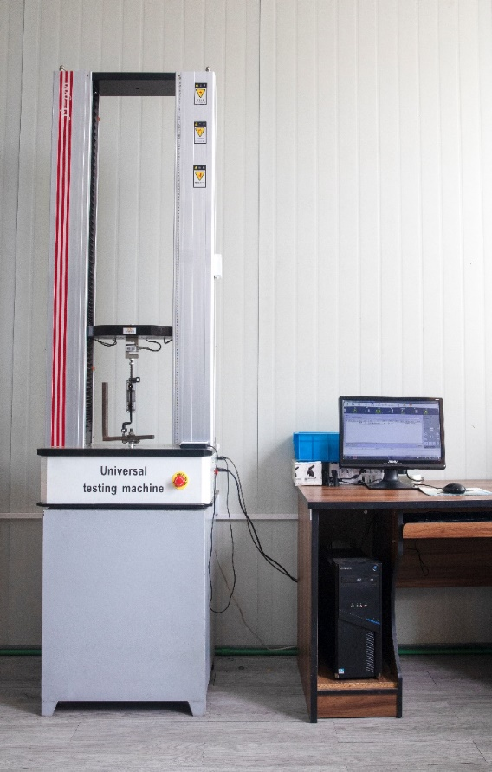
Equipment-R&D Test
Performance testing of
high and low temperature tensile
machines (plastic particles, joints)
Pressurized blasting test bench
Normal temperature tensile test bench

Slide 15
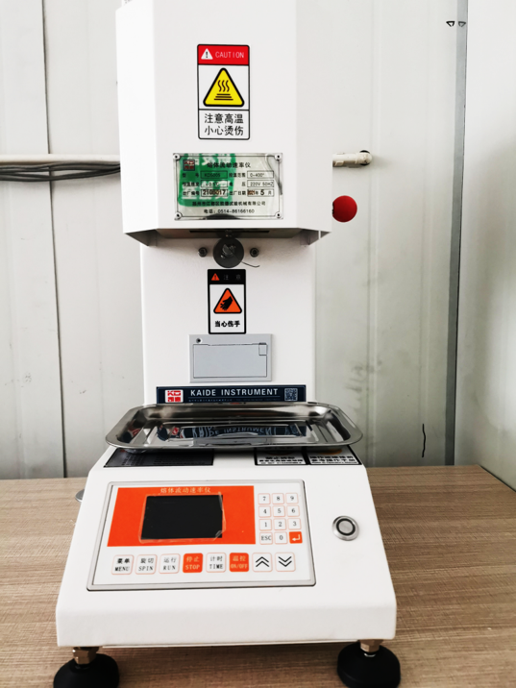
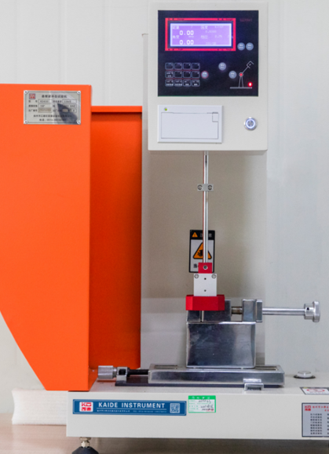
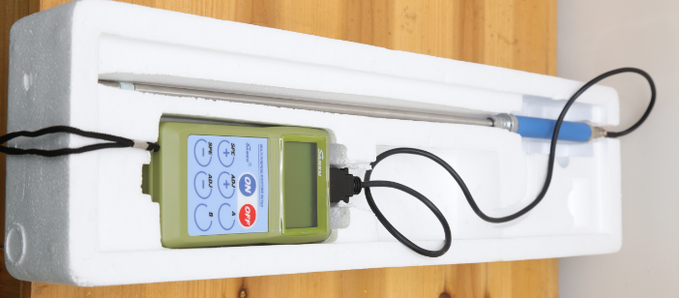
Equipment-R&D Test
Determination of Melt Index
of Plastic Particles
Plastic Impact Test
Dry humidity monitoring of
plastic particles

Slide 16
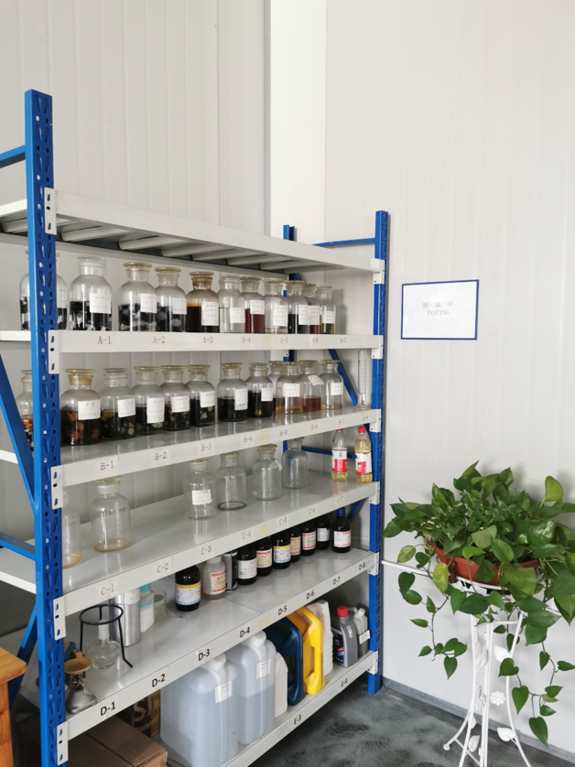
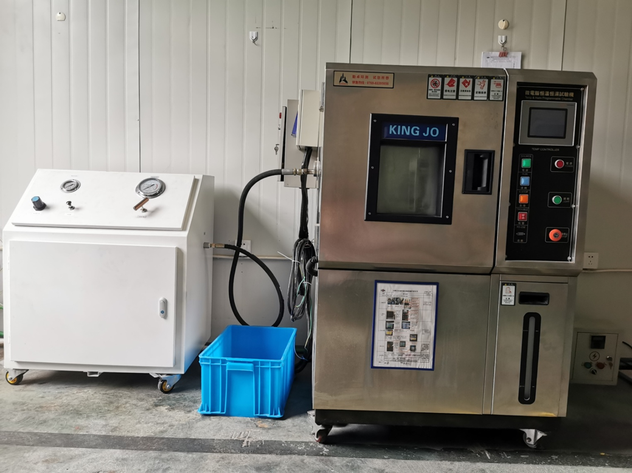
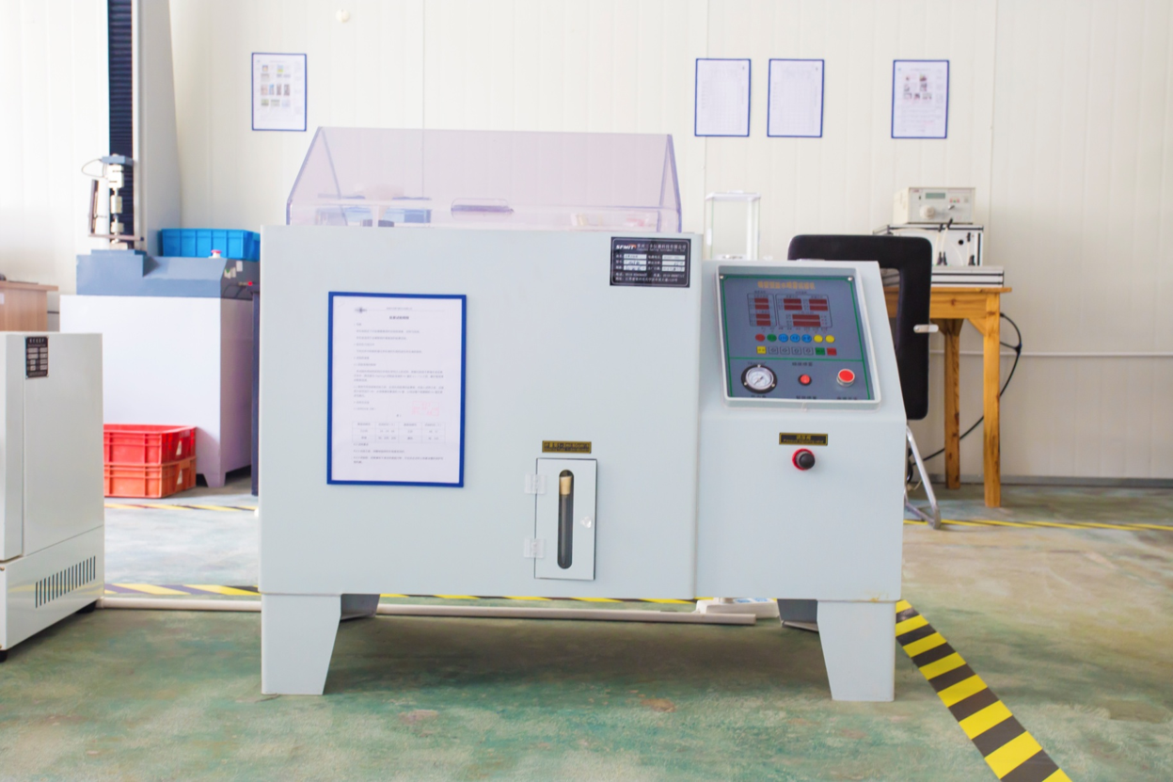
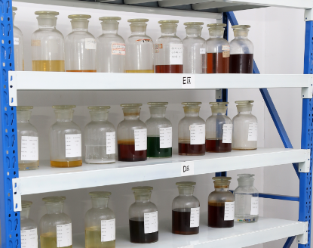
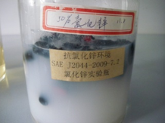
Equipment-R&D Test
High and low temperature
alternating test
Salt spray test
Fuel compatibility test
Anti-external chemical test
Zinc chloride resistance test

Slide 17
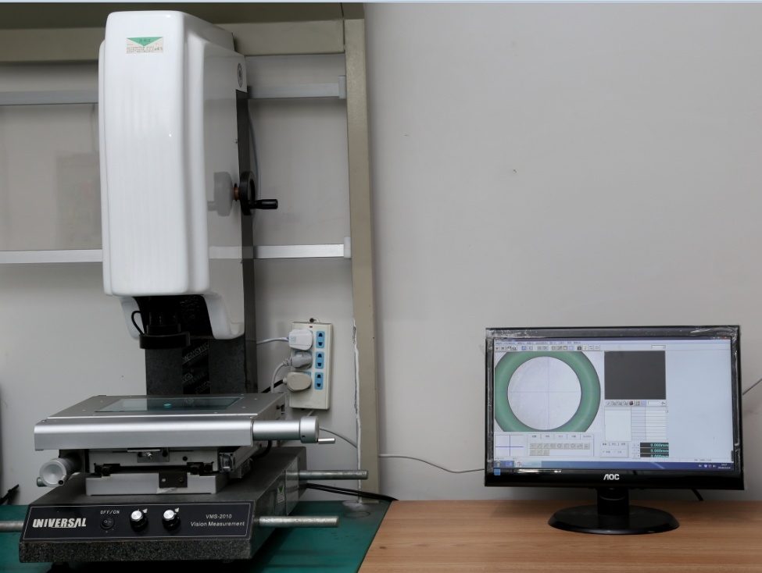
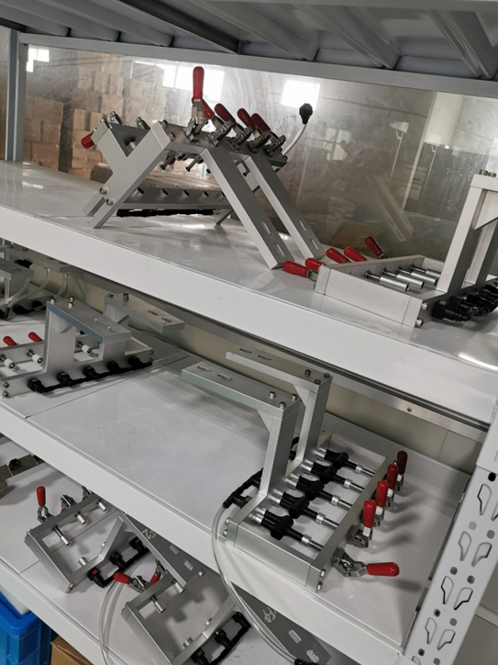
Equipment-Inspection and Testing
Dimension Test for O-rings
Non-standard product leakage
inspection tooling

Slide 18
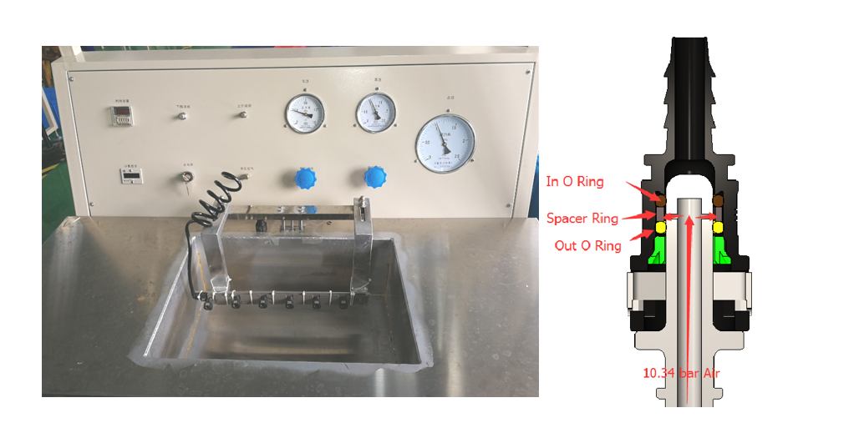
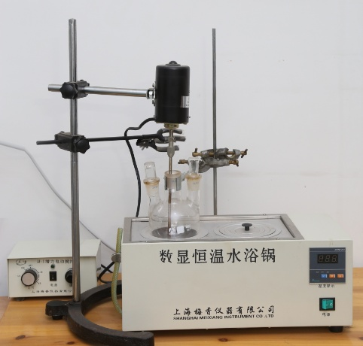
Equipment-Inspection and Testing
100% leak test
Self-designed and manufactured online leak detection
Leakage probe, the size conforms to the SAE standard, the outer diameter of the probe uses the following tolerance: Φ 7.81-7.83,Standard size of 7.89 male connector: Φ 7.89±0.06
Constant temperature
water bath pot

Slide 19

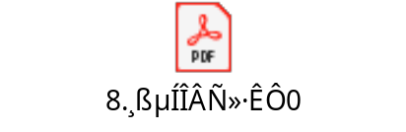
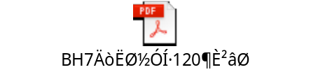
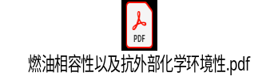
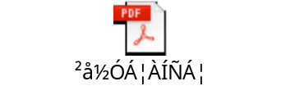
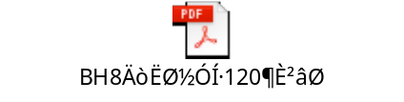
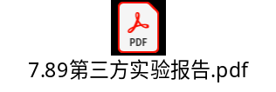
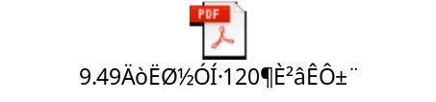

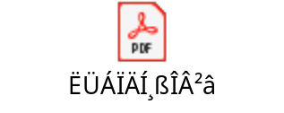


Product performance
快速接头泄露检测报告

Slide 20
03 Capacity
Capacity
Production Equipment
Assembly workshop
Quality management
03
——CONTENTS——

Slide 21
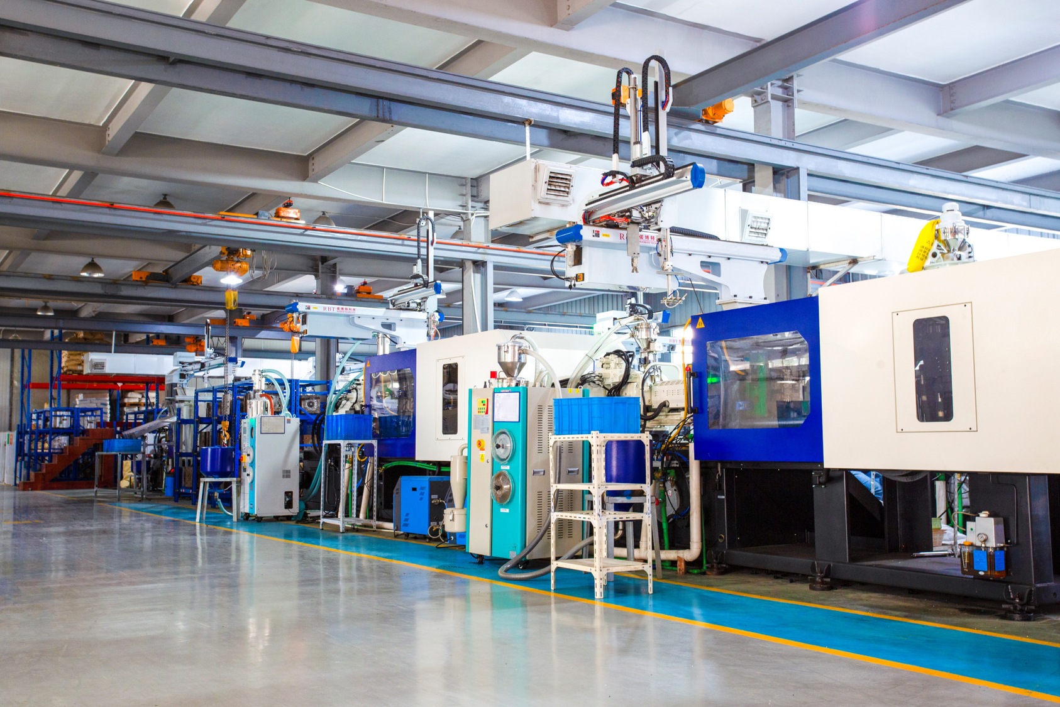
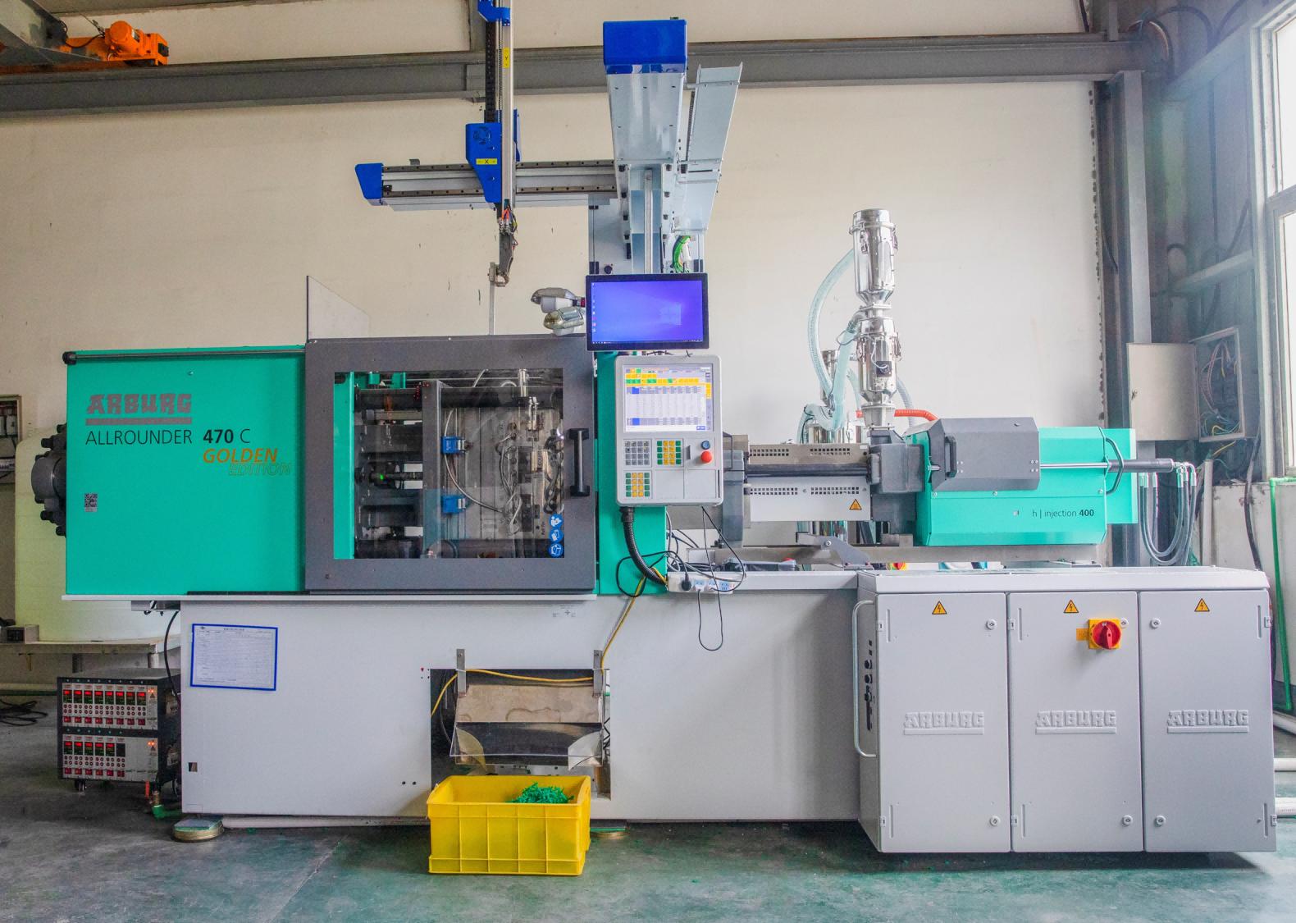
Production Equipment-Injection
35 set injection molding machines
1 set German Agbo 470C

Slide 22
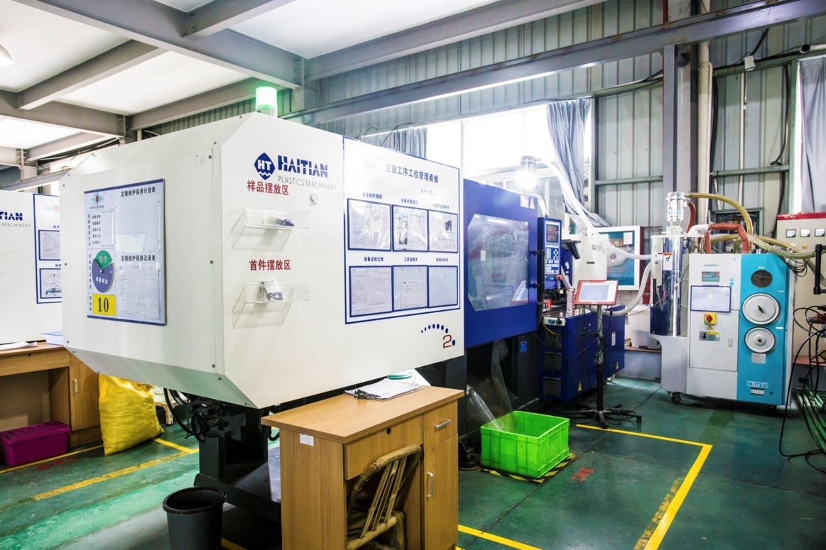
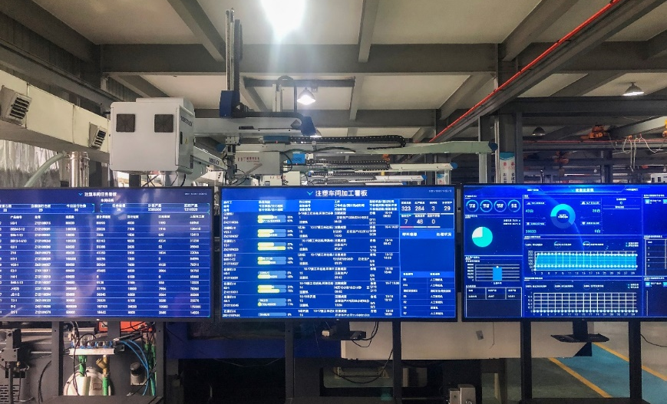
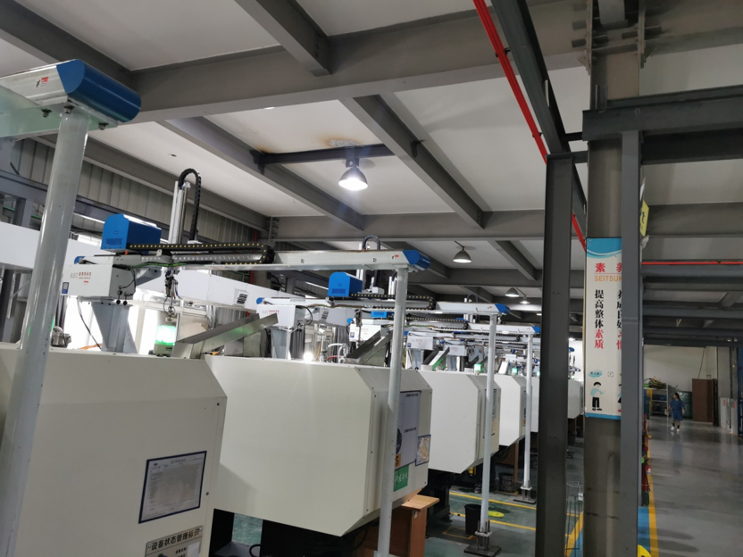
Production Equipment-Injection
More than 30 programmable
drying and conveying machines
MES production management system
There are 35 three-axis manipulators， which can form a one-piece conveyor belt for injection molding machines.

Slide 23
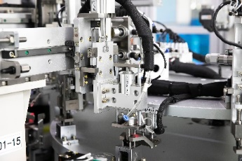
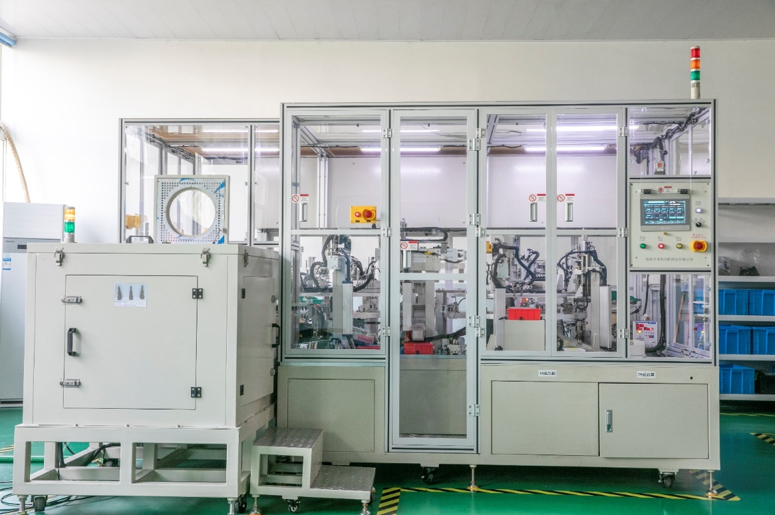
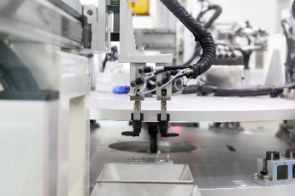
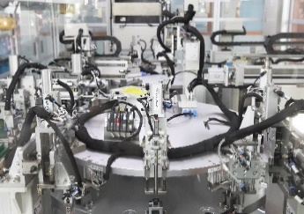
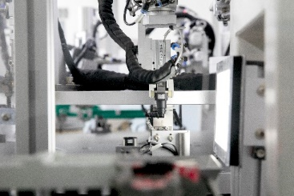
Equipment-Assembly
4 set automatic assembly machines

Slide 24


Quality management
IATF16949: 2016 Certification

Slide 25
04 Customers
Customers
Main Customers-Tier 2
04
——CONTENTS——

Slide 26













Main Customers-Tier 2

Slide 27
THANKS
临海市永恒汽配科技有限公司
Linhai yongheng Auto Parts Technology Co., Ltd

